Slide 1
Protein 3-D Structure Representation for Alignment-Free Comparison and Structural Motif Discovery of Proteins
Sumi Singh
The Center for Advanced Computer Studies
3/3/2017

Slide 2
Outline
Introduction
Structure representation
Functional prediction
Classification
Conclusions

Slide 3
Outline
Introduction
  Protein Structure
  Need for Protein Structure Comparison
  Steps for Comparing Protein Structures
  Methods of Comparison

Slide 4
Outline
Introduction
  Protein Structure
  Need for Protein Structure Comparison
  Challenges
  Methods of Comparison

Slide 5
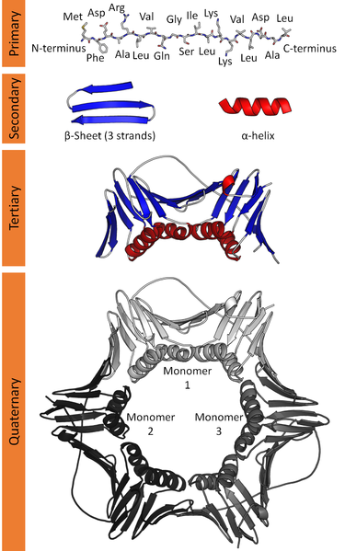
Increased complexity and function

Slide 6
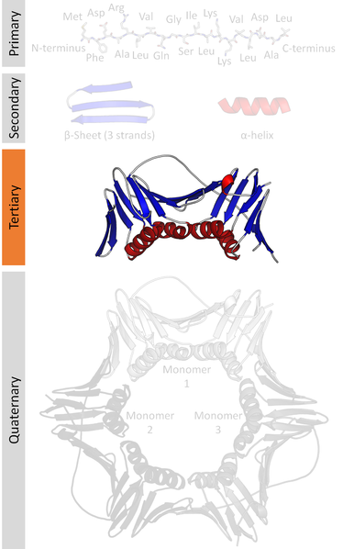
Increased complexity and function

Slide 7
Outline
Introduction
  Protein Structure
  Need for Protein Structure Comparison
  Steps for Comparing Protein Structures
  Methods of Comparison

Slide 8
Significance of protein 3D/ Tertiary structure comparison
Structural similarity between two proteins means functional similarities
Predict binding site
Predict drug interaction
Drug design
Drug delivery
Pharmacophore design
Substrate interaction
Metabolic pathways
Disease pathways
Notes:
Why is it useful.. Medicines have a pathway and their functionality can be well determined by knowing the function of proteins they interact with

Slide 9
Outline
Introduction
  Protein Structure
  Need for Protein Structure Comparison
  Steps for Comparing Protein Structures
  Methods of Comparison

Slide 10
  Steps for Comparing Protein Structures
Define Structural Unit
Degree of Comparison
Method for Comparing
Establishing Statistical Equivalence
Notes:
Range of structure far more constrained due to chemical and physical forces
No definition of an optimal 3D alignment
Random protein structure definition is not clear
Difficulty to compare totally different protein structures
Homology or analogy

Slide 11
Challenges
Range of structure far more constrained due to chemical and physical forces
No definition of an optimal 3D alignment
Random protein structure definition is not clear
Difficulty to compare totally different protein structures
Homology or analogy
Choice of UNIT
Amino Acid
Secondary Structure
Degree of Comparison
Rigid | Flexible
Sequential | Non-sequential
Global | Local

Slide 12
Outline
Introduction
  Steps for Comparing Protein Structures
    Define Structural Unit in 3D
    Degree of Comparison
    Methods for Comparing
    Establishing Statistical Equivalence

Slide 13
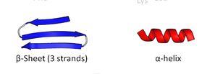


“Unit” in 3D
NH₃⁺
C_{α} (Centroid)
COO⁻
Secondary Structure
An Amino Acid
Notes:
X,y,z coordinates for Centroid of amino acids are represented by c-alpha atom

Slide 14
Outline
Introduction
  Steps for Comparing Protein Structures
    Degree of Comparison
      Rigid vs. Flexible
      Sequential vs. Non Sequential
      Global vs. Local

Slide 15
Outline
Introduction
  Steps for Comparing Protein Structures
    Degree of Comparison
      Rigid vs. Flexible
      Sequential vs. Non Sequential
      Global vs. Local

Slide 16
Rigid vs. Flexible
(x, y, z) coordinates for every atom of every amino acid in sequence
X-ray diffraction method-Only one Rigid Model
Nuclear magnetic resonance method- Multiple Flexible Models
Protein structures are flexible and conformation(ally)
changeable in response to binding another molecules relating
with biological functions
Notes:
How do we get the coordinates in the atoms of proteins?

Slide 17
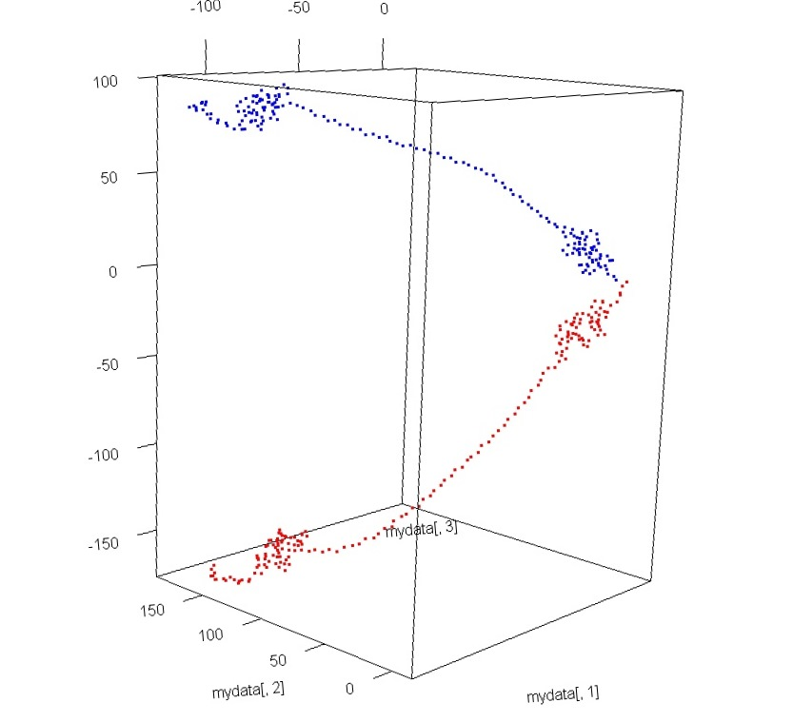
Limitations of coordinate assignment methods
PDBID:1b8t chain A NMR model 1
Lack of common frame of reference
Same protein, two experiments, two sets of coordinates
PDBID:1b8t chain A NMR model 10
Notes:
The two models of the same protein chain. They should have very same coordinates. But as we can see that is not true.

Slide 18
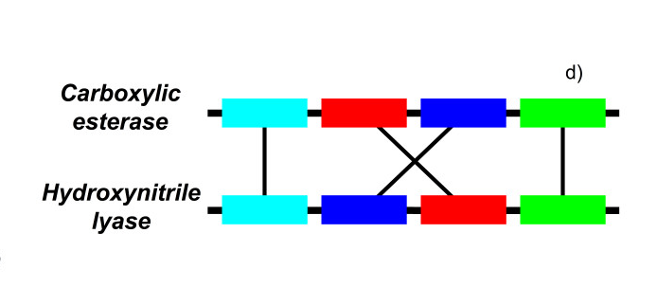
A comprehensive analysis of non-sequential alignments between all protein structures
Alexej Abyzov andValentin A IlyinEmail author
BMC Structural Biology20077:78
DOI: 10.1186/1472-6807-7-78© Abyzov and Ilyin; licensee BioMed Central Ltd. 2007
Received: 14 May 2007Accepted: 16 November 2007Published: 16 November 2007

Slide 19
Outline
Introduction
  Steps for Comparing Protein Structures
    Degree of Comparison
      Rigid vs. Flexible
      Sequential vs. Non Sequential
      Global vs. Local

Slide 20
Non sequential comparisons
A non-sequential alignment is an alignment where structurally similar parts are not in the same order in protein sequences.
Circular permutation resulted by precursor gene duplication.

Slide 21
Outline
Introduction
  Steps for Comparing Protein Structures
    Degree of Comparison
      Rigid vs. Flexible
      Sequential vs. Non Sequential
      Global vs. Local

Slide 22
Global vs. Local Comparison
Global
Local

Slide 23
Outline
Introduction
  Protein Structure
  Need for Protein Structure Comparison
  Steps for Comparing Protein Structures
  Methods of Comparison
    Alignment Based
    Descriptor Based

Slide 24
Outline
Introduction
  Steps for Comparing Protein Structures
    Define Structural Unit in 3D
    Degree of Comparison
    Methods for Comparing Protein Structures
    Establishing Statistical Equivalence

Slide 25
Outline
Introduction
  Steps for Comparing Protein Structures
    Methods for Comparing
      Alignment Based Methods
      Descriptor Based Methods

Slide 26
Protein structure comparison using Structural Alignment
Translation
Rotation
Rotation

Slide 27
Inter-atomic distance
3-D structures
d₁₁
d₁₂
Root-mean-square deviation (RMSD)
Skeletons
Distance calculation
Rotation
Translation
Representative points
Notes:
One of the two broad classes of alignment based protein structure comparison methods is inter atomic distance based method

Slide 28
Intra-atomic distance
3-D structures
Skeleton
Points
Distance Matrices
Convert structure information into distance matrix.
The algorithms look for similar sub matrices with similar distance profile.
Notes:
Another alignment based method is intra-atomic distance based method. This method finds distance between all the atoms of the protein with respect to the seed element. Then find the similar sub matrices across the various structures.

Slide 29
Challenges with alignment
Computational expenses and inefficient for real time database search
Lack of sequence information
Lack of scale sensitivity
Global alignment does not mean good local alignment
Sequential
Notes:
Sequence forms the backbone of the tertiary structure and should not be ignored.

Slide 30
Outline
Introduction
  Steps for Comparing Protein Structures
    Methods for Comparing
      Alignment Based Methods
      Descriptor Based Methods

Slide 31
Descriptor based methods
Nonalignment- approaches based on descriptors of molecular shape
Descriptors are represented by histograms or vectors
Similarity score between two molecules is calculated from corresponding descriptors without any alignment
Affine/Similarity transformation and hinge rotation is performed to bring all structure in same reference frame

Slide 32
Advantage
Non-alignment or descriptor based approaches are generally fast enough to search a large database in a real-time manner

Slide 33
Outline
Introduction
  Steps for Comparing Protein Structures
    Define Structural Unit in 3D
    Degree of Comparison
    Methods for Comparing Protein Structures
    Establishing Statistical Equivalence

Slide 34
Statistical Equivalence and Reliability
High similarity reflects common ancestry (homology) or convergence to a similar structure from independent origin ( analogy)
To address this concern: Unrelated sequence with less than 40% known homology is utilized
Establish statistical significance using Extreme value deviation or Normal distribution
Poisson distribution to estimate the closeness of estimate and expected value using the prior knowledge

Slide 35
Challenges with Descriptor based Method
Reference frame transformation
Residue information
Non-Sequential Local comparisons

Slide 36
Outline
Introduction
Structural Fingerprints
Use triangular spatial relationships in 3-D for functional prediction
Use triangular spatial relationships in 3-D as features for classification
Conclusions

Slide 37
Choice of Structural Unit
H
NH₃⁺
C_{α} (Centroid)
COO⁻
R
Approximate the residue by limiting its
representation to coordinates of C_{α} atom
Assign a unique ID or Label to each residue

Slide 38
Structural Unit
A Structural Patch/Triple defined by triple of all amino acids
Each Patches (Triples) of 3-amino acid is represented by its C_{α}, n(n-1)(n-2) possible patches for n amino acids

Slide 39
Feature Space
Feature from each patch must be a good descriptor of its shape.
Transforms a Patch to non-homogenous feature space -> (S) of dimension m, where m is the number of features selected.

Slide 40
Structural Patch represented by quintuple of features
{Label₁, Label₂, Label₃, θ, D}
Labels represent Primary Structure (amino acids sequence)
Theta represents orientation
Length represents size/scale
Tertiary/ 3D structure
Notes:
Theta and Length represent the Tertiary or 3d structure.
Labels are primary structure formed by the amino acid residues.

Slide 41
Sample Feature Space
Label₁
D
Label₂
θ
Label₃

Slide 42
Feature Space
Label₁
D
Triple/Patch
Label₂
θ
Label₃

Slide 43
Patch Fingerprint
Desired properties
  Rotation, translation, invariant
  Scale variant
Point Transformation defined in the feature space (S)
Key Value Pair for the points

Slide 44
Structural Fingerprints
Triangular Spatial Relationships

Slide 45
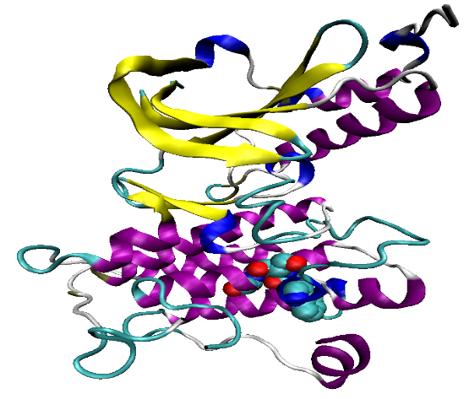
PBD ID: 1R0P
F(A_{i}²)-> l₂
A_{i}²
A_{i} ³
F(A_{i}³)-> l₉
A_{i}¹
F(A_{i}¹)-> l₅
Assign labels to amino acids in triple
AminoAcid ∈ A; l₁, l₂, l₃, .., l₂₀ ∈ A ; F : A → Z⁺
Mapping of Amino Acid
_{i} | A¹ | A² | A³
1 | l₅ | l₂ | l₉
2
3
4
5
 | : | : | :
Generate all possible triples of amino acids present in the protein structure-sequence. Each amino acid A^{n} in the triple is represented by the (x, y, z) coordinate of centroid (C_{α} ). Superscript 1, 2, 3 represent the position of amino acid in the sequence. The subscript i represent the (i^{th}) triple under consideration.
K=f_{3-D}(Quintuple_{3-D})
Rule Based Quintuples_{3-D}
_{i} | Label₁ = F(l₂) | Label₂ = F(l₅) | Label₃ = F(l₉) | Class label θ for Angle θ₃ | Class label D for Length D₁₂
1 | 2 | 5 | 9 | 3 | 2
2
3
4
5
 | : : | : : | : : | : : | : :
Perform rule based label arrangement in every triple (i)
K | V
: : | : :
Label₂ := 5
D₁₂
Calculate
Key
_{θ3}
Label₃ := 9
Label₁:= 2
Key (K) value (V) pair where value is the number of times that key occurs in the protein
Label₁, Label₂, Label₃ represent 1st, 2nd and 3rd vertices of the triangle formed by a triple of amino acid after rule based label arrangement. The representative Angle Θ₃ and Length D₁₂ are calculated based on these labels.

Slide 46
Key Calculations
{Label₁, Label₂, Label₃, θ, D}
Scale Sensitivity
k=θ_{T} d_{T} (Label₁-1) m²+ θ_{T} d_{T} (Label₂-1) m+ θ_{T} d_{T} (Label₃-1)+ d_{T} (θ-1)+(D-1)

Slide 47
Key Calculations
{Label_{1(e)}, Label^{e}_{2(e)}, Label_{3(e)}, θ, D}
Evolution Sensitivity using Amino Acid Evolutionary Grouping
Scale Sensitivity
k=θ_{T} d_{T} (Label_{1(e)}-1) m²+ θ_{T} d_{T} (Label_{2(e)}-1) m+ θ_{T} d_{T} (Label_{3(e)}-1)+ d_{T} (θ-1)+(D-1)

Slide 48
Discretization – Flexibility To Comparison
Equal width/range was inconsistent with the angle and length distribution of TSR in 3-D
To prevent mis-assignment of patch to a key Adaptive unsupervised Iterative Discretization technique proposed for discretization

Slide 49
Adaptive binning
ADAPT the bin boundaries to ensure all occurrences of same values are in one bin.
For a value x, that is not completely in the bin i, if frequency (f_{i}) > expected frequency (e)
Include all instances of x in bin i
f_{i}+= frequency of inclusion
Exclude all instances of x from bin i
f_{i}-= frequency of exclusion
dev+=abs(e-f_{i}+)
Calculate deviation
dev-=abs(e-f_{i}-)
min(dev+, dev-)
Bin boundary decision

Slide 50
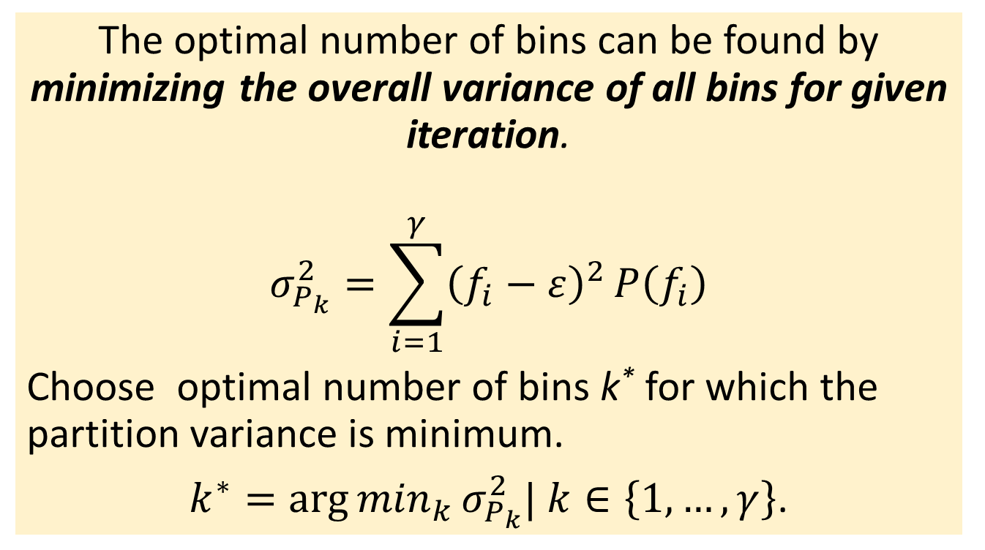
Optimal number of bins
The optimal number of bins can be found by minimizing the overall variance of all bins for given iteration.
$$σ_{P_{k}}^{2}=\sum_{i=1}^{γ}{{\left(f_{i}−ε\right)}^{2}}P\left(f_{i}\right)$$
Choose optimal number of bins k* for which the partition variance is minimum.
$k^{∗}={\arg{min}}_{k}σ_{P_{k}}^{2}| k∈\left\{1,…, γ\right\}$.
Notes:
Overall variance is calculated for a given iteration as sum of deviation for each bin. The optimal number of bins are chosen based on minimizing the variation.

Slide 51
Statistical Measure for Global Non Sequential Similarity
Generalized Jaccard Similarity for pair wise similarity
A is multiset f keys in protein p1
B is multiset f keys in protein p2
J(p1,p2)=|A∧B|/|A∨B|
Where
|A∧B| is equivalent to minimum count of keys in (A),(B)
|A∨B| is equivalent to maximum count of keys in (A),(B)

Slide 52
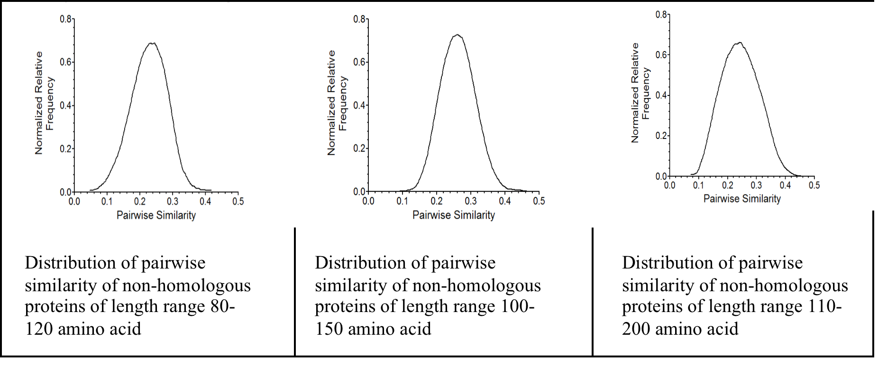
Extreme Value Distribution- Statistical Significance

Slide 53
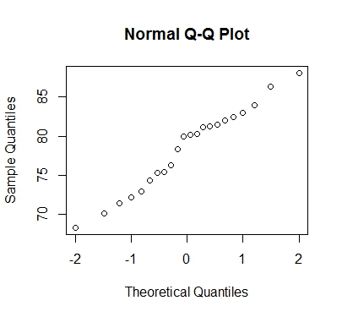
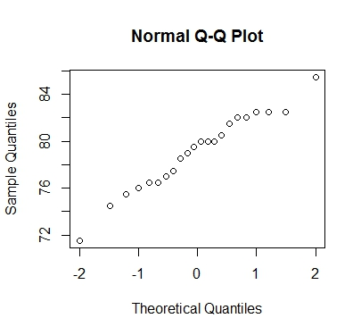
Compare pairwise similarity using generalized Jaccard (TSR 3-D) with FATCAT
Test of normality for pairwise similarity calculated using Jaccard Coefficient
Test of normality for pairwise similarity calculated using FATCAT method

Slide 54
Outline
Introduction
Triangular spatial relationships for protein 3-D structure representation
Functional prediction
Use triangular spatial relationships in 3-D as features for classification
Conclusions

Slide 55
Structural taxonomy
Structurally most distant
Class
Fold
Superfamily
Family
Increase in structural distance
Distant Homologues with significant structural similarity
Structurally
most similar. Called HOMOLOGUES.
May be functionally similar
Based on Physio-Chemical properties

Slide 56
Finding functional groups
Traditionally Functional Groups are found by performing sequence alignment to look for conserved groups of amino acids
Phylogeny tree is used for clustering similar protein groups, sometimes these groups are functional groups
Structure is more conserved functionally compared to sequence

Slide 57
Structural Fingerprints for Structural Motif Discovery

Slide 58
DFG: Structurally conserved using TSR Fingerprints in 3-D
Aspartate-Phenylalanine-Glutamate
motif in protein kinase
Low mean absolute deviation
across various protein kinases
Notes:
D= aspartic acid, G=glycine, F=phenylalanine
Keys of same motifs that are structurally conserved are expected to follow a distribution. We found that DFG has a low mean absolute deviation of [1,2] for both homologous and non homologous protein kinases.

Slide 59
Aspartate-phenylalanine-glycine motif
Notes:
DFG in Sequence alignment

Slide 60
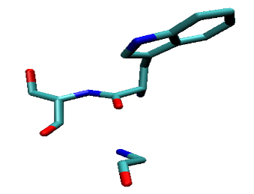
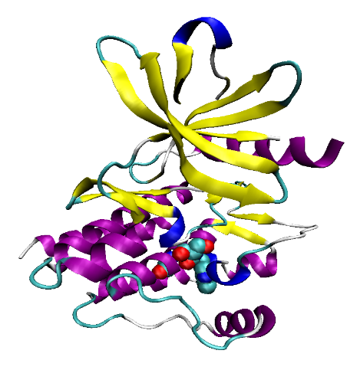
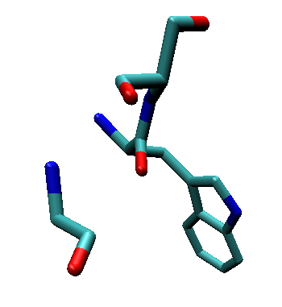
Tryptophan-serine-x-glycine motif
1r0p
WS-x-G Motif
W1267 S1268 G1270
1xbc
W556 S557 G559
Notes:
Another motif discovered in sequence as well as structure using TSR 3-D structural fingerprint
Here (x) can be any other amino acid

Slide 61
Tryptophan-serine-x-glycine motif
Notes:
As seen in the sequence alignment.

Slide 62
Discovery of structural motifs that were not seen in sequence alignment

Slide 63
Structural Motifs Using TSR 3-D Fingerprints
Fingerprint subset selection using Mean Absolute Deviation
Create a Geometric Hash Table to save position information of patch with respect to a seed (usually the first amino acid)
Iteratively find the longest substructures of size s present in k proteins. Vary s and k until threshold.

Slide 64
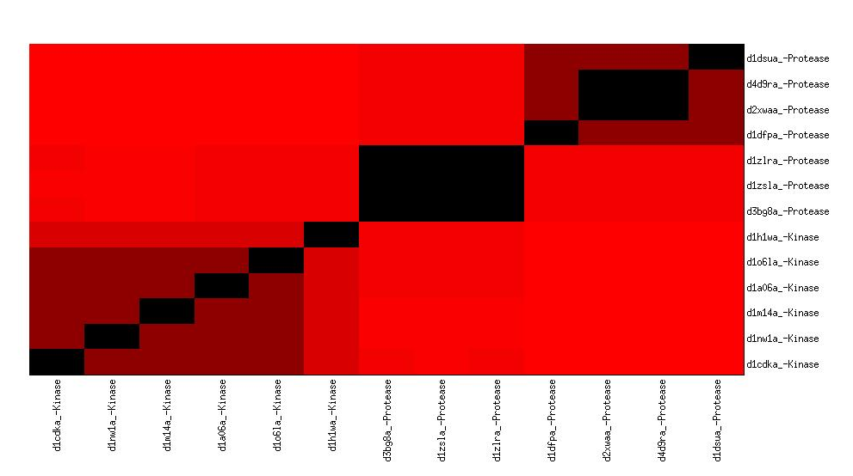
Protease vs. Kinase
Group Protease
Group Kinase

Slide 65
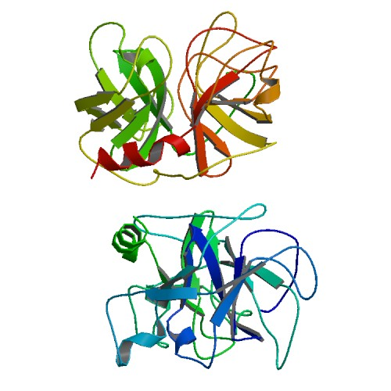
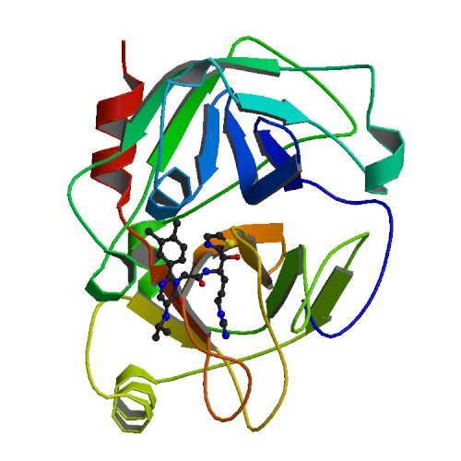
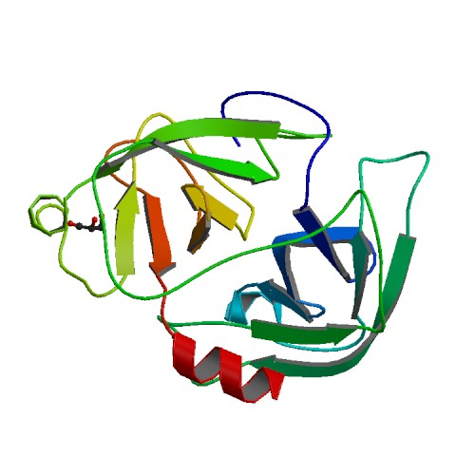
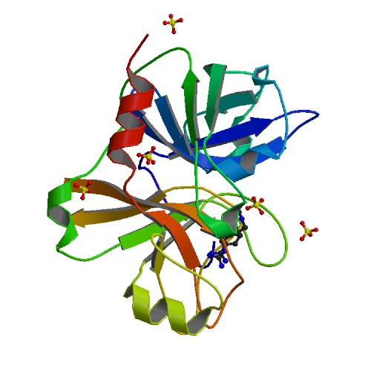
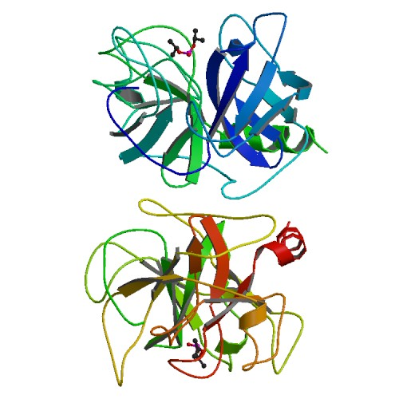
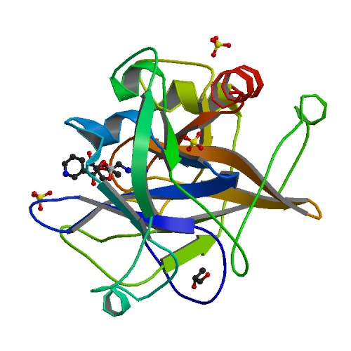
Predicting local functional groups in Protease
1dsu
3bg8
Factor XI
Factor D
2xwa
1zsl
1dfp
1zlr

Slide 66
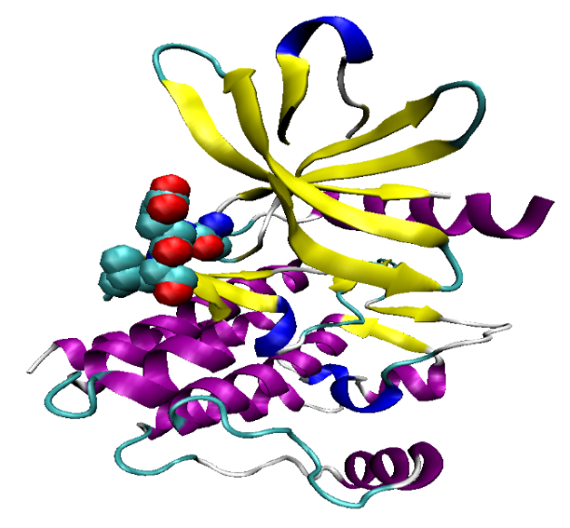
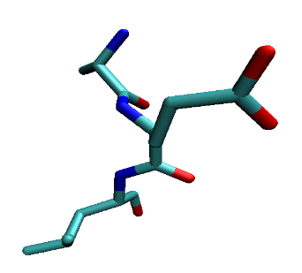
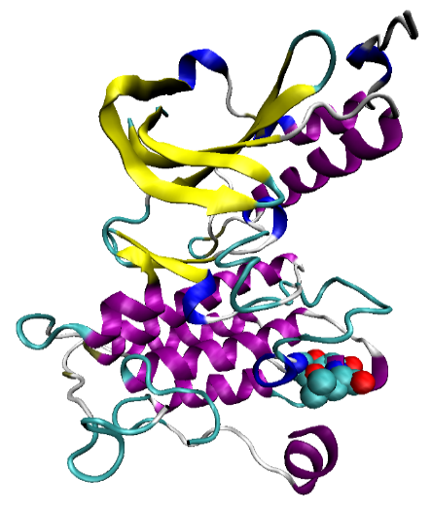
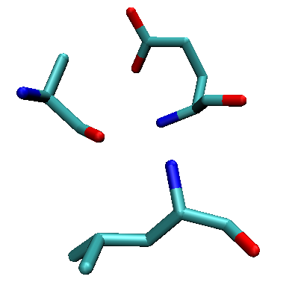
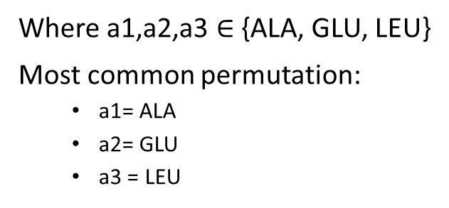
Alanine-x-glutamate-x-leucine Motif
1xbc
Where a1,a2,a3 {ALA, GLU, LEU}
Most common permutation:
  a1= ALA
  a2= GLU
  a3 = LEU
A451 E452 L453
1r0p
A1251 E1253 L1255

Slide 67
GGLLDH Motif
2etr
2r5t
GGLLDH
GGLLDH
Notes:
The lower figure shows the structural motif as seen after zooming in. It can be seen that the two sub-structures are very similar in the 3-D space.

Slide 68
LEHIHRDD Motif
2nru
3dtc
LEHIHRDD
LHEIHRDD
E259
L302
H309
E304
L256
D311
H266
H257
H306
D369
D331
I265
I308
L268
R267
R310

Slide 69
Outline
Introduction
Structure representation
Functional prediction
Classification
Conclusions

Slide 70
Structural taxonomy
Structurally most distant
Class
Fold
Superfamily
Family
Increase in structural distance
Distant Homologues with significant structural similarity
Structurally
most similar. Called HOMOLOGUES.
May be functionally similar
Based on Physio-Chemical properties

Slide 71
Challenges with protein classification
Multiclass classification
Hierarchical classification

Slide 72
Purpose
Proteins have natural structural hierarchy
Can TSR-3-D Structural Fingerprints be used as structural features for performing hierarchical classification of proteins based on their structures?

Slide 73
Automatic protein structure classification Systems
Multiclass classification of protein structures
The features used are combinations of
  statistics on amino acid residue of the proteins,
  statistics on their secondary structure elements and
  interatomic distance matrix based features
These features are complex and require higher computational costs
Flat classification loses the hierarchy information
Notes:
This slide describes the common automatic protein structure classification system. Most of these systems use Multiclass classification systems. They ignore the inherent hierarchical nature of protein structure.

Slide 74
Flat classification
R
1
2
11
12
21
22
211
212
2111
2112
Flat classification- predict leaf node
Just predicts leaf nodes
Not truly hierarchical
Attribute selection is done for all classes at leaf node level
Notes:
Most of the implementation multiclass classifier can also be considered similar to flat classification.

Slide 75
Proposed approach
R
1
2
11
12
21
22
211
212
Local classifier per parent node
Attribute selection per parent node
Training set selection policy for multiclass hierarchical classification
Trains classifier only at parent nodes
Truly hierarchical
Decision tree based attribute selection
All-descendants’ policy
Evaluation
Misclassification at any level is penalized and the instance is considered incorrectly classified
2111
2112
Attribute selection at ROOT level classifier
(AS)C11
Attribute selection all CLASS level classifiers
(AS) C21
(AS) C22
(AS) C23
(AS) C24
R
1
2
11
12
21
22
211
212
2111
2112
Training

Slide 77
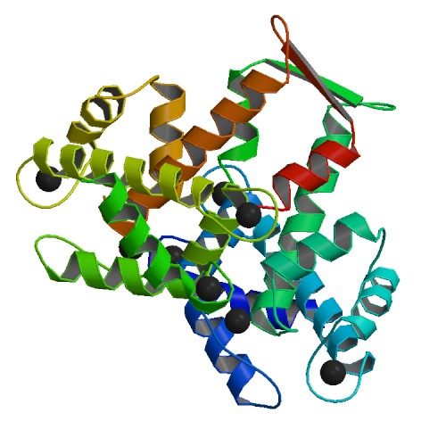
Discovery- Ca⁺ Binding Protein Family
  1a4p ENSG00000197747 (H. sapien)
  1alv ENSG00000126247 (H. sapien)
  1eg3 ENSG00000198947 (H. sapien)
  1h8b ENSG00000077522 (H. sapien)
  1j7q Ca Vector Protein (B. lanceolatum )
  1k8u ENSG00000197956 (H. sapien)
  1k94 ENSG00000115271 (H. sapien)
  1k9u Ca-binding protein (P. pratense)
  1m45 ENSG00000100427 (H. sapien)
Test Protein:
1iio is a Hypothetical Protein (M. thermoautotrophicum) is grouped with this Ca⁺ binding protein.
Hypothesis : 1iio exhibits Ca²⁺ binding activity in M. thermoautotrophicum, possibly through a EF hand or EF hand-like motif.

Slide 78
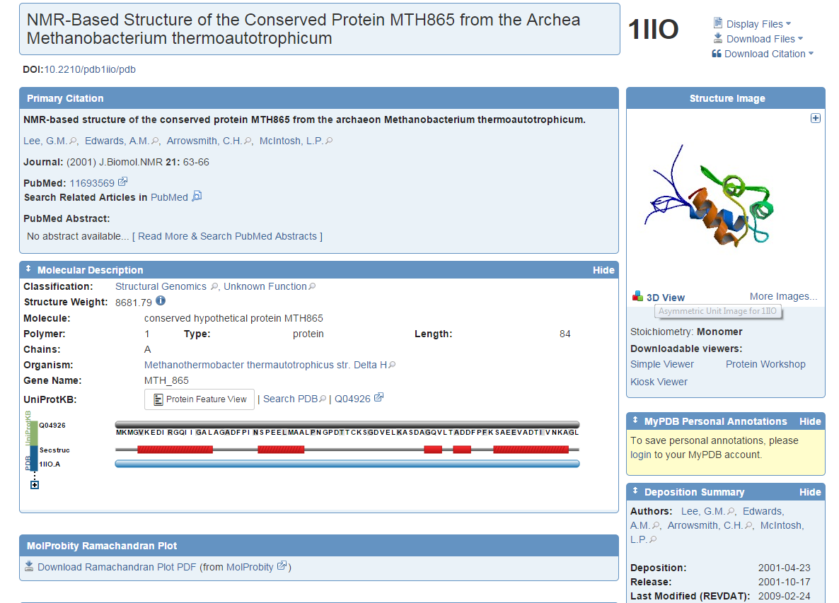

Slide 79
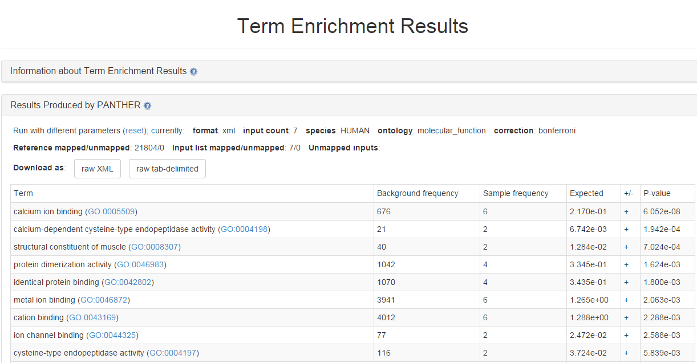
Molecular Function Enrichment Of the 7 annotated protein/genes

Slide 80
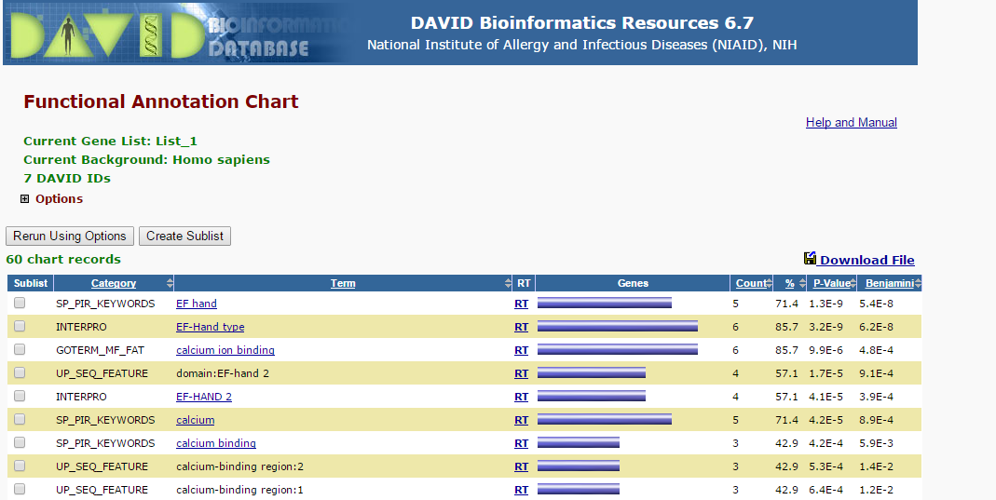
Functional Enrichment Of the 7 annotated protein/genes reveals 5 that have know EF hand motifs: http://en.wikipedia.org/wiki/EF_hand

Slide 81
Outline
Introduction
Structural representation
Functional prediction
Classification
Conclusion

Slide 82
Conclusions
The pairwise global structural similarity measure calculated using TSR in 3-D have been found to be comparable to other methods.
TSR in 3-D can identify local similarity and structural motifs .
TSR in 3-D can be used to perform structural classification based on protein structure taxonomy.

Slide 83
Conclusion- Functional Annotation and Gene Annotation

Slide 84
Alanine-x-glutamate-x-leucine Motif
1xbc
Where a1,a2,a3 {ALA, GLU, LEU}
Most common permutation:
  a1= ALA
  a2= GLU
  a3 = LEU
A451 E452 L453
1r0p
A1251 E1253 L1255

Slide 85
GGLLDH Motif
2etr
2r5t
GGLLDH
GGLLDH
Notes:
The lower figure shows the structural motif as seen after zooming in. It can be seen that the two sub-structures are very similar in the 3-D space.

Slide 86
LEHIHRDD Motif
2nru
3dtc
LEHIHRDD
LHEIHRDD
E259
L302
H309
E304
L256
D311
H266
H257
H306
D369
D331
I265
I308
L268
R267
R310

Slide 87
Conclusion
Context based multiple class amino acid, angle and length group memberships. This membership is defined by the ability/ probability of an amino acid to be in a given class.
Hierarchical data base for substructure.

Slide 88
Thank you

