Slide 1
Aging Cell Morphology: Identifying cellular transformations associated with aging using image processing
Final Project Presentation
BMI260-SP2019
Sumi Singh
Kavita Kulkarni
Ken Xiong
Mahdi Moqri
Notes:
In this project we are trying to identify cellular transformation associated with aging using image processing. I am Sumi Singh and My team mates are Kavita, Mahdi, and Ken

Slide 2
Motivation
For most of the last century, social policies have focused on increasing life expectancy in the population; but in recent decades, policy and research are increasingly focused on the potential of increasing healthy life or health-span.
This leads us straight to exploring the mystery of “aging”.
Notes:
To explore the mystery of aging→which is responsible for pre-mature non infectious deaths and ailments. And the potential of increasing healthy life or health-span.

Slide 3
Goal
Find signs of aging at cellular level.
Notes:
To extract geometric and textural image features from cellular images taken at different ages. These features will help in classifying the new test images based on age.
We also hope to extract some image biomarkers of aging.

Slide 4
More Specifically-Goal Again!
Extract geometric and textural features from microscopic histo-pathological images taken at different ages, to be able to classify these images based on the age of the subject.
Predict Age
From
Images
Notes:
To extract geometric and textural image features from cellular images taken at different ages and use them to predict age.

Slide 5
More the Merrier: From Goal to Goals
We assume that a set of features extracted from these images, may be considered as image biomarkers of aging.
Extract biomarkers
Notes:
extract some image biomarkers of aging.

Slide 6
Material and Method

Slide 7
How
Investment
Benefit
Geometric and Texture feature extraction and feature space representation
(Avg. across cell nuclei per slice)
Histology image preparation
Segmentation
Prediction
BLOB DETECTION
Channel Deconvolution
Notes:
Histology image- deconvoled into channels, segmented, feature extraction and prediction

Slide 8
Data Source and Considerations
Investment
Benefit
Overview of data - Public Data Source
Data source : Atlas of Gene Expression in Mouse Aging Project (AGEMAP)*
Distribution : 30 male & female mice, of ages 1, 6, 16, and 24 months (TARGET)
Channels : hematoxylin and eosin (H&E)
Device used : bright-field Carl Zeiss Axiovert 200 microscope
Data volume: 1500 images with 40x resolution, each a 1388x1040 RGB TIFF with 12 bits of quantization per channel (12GB)
Considerations and Assumptions
High similarity between mouse and human tissue
Since the dataset we have is very small, our ML methodology leverages classical ML approaches rather than deep learning
For the purpose of this task we consider the target class membership as nominal and assume that the order of the classes based on the age has no inherent effect on the prediction.
*Zahn, J.M., Poosala, S., Owen, A.B., Ingram, D.K., Lustig, A., Carter, A., Weeraratna, A.T., Taub, D.D., Gorospe, M., Mazan-Mamczarz, K. and Lakatta, E.G., 2007. AGEMAP: a gene expression database for aging in mice. PLoS genetics, 3(11), p.e201.
Notes:
We use public data source on Mouse Aging that has 1500 images from 30 male-female mice from 1, 6, 16 and 24 months old. Age is the target and considered as nominal type for simplicity.

Slide 9
1. Image preparation
Notes:
Step 1

Slide 10
Hematoxylin Channel
There were two obvious candidates to be segmented for downstream processing - cell nuclei and cell cytoplasm.
Segmenting the former proved to be a much more straightforward task than so with the latter, which made it the more productive endeavor.
First, each RGB image was deconvolved into channels representative of hematoxylin (hema), eosin (eos), and 3,3'-Diaminobenzidine (DAB).
The chemistry of the stains is such that hematoxylin is concentrated in cell nuclei and eosin gathers in the cytoplasm. Accordingly, the hematoxylin channel was used to segment nuclei.
Notes:
Images are stained using hemtoxylin and eosin stains. So RGB needs to be deconvolved into hematoxylin, eosin channels. the hematoxylin channel was used to segment nuclei.

Slide 11
2. Segmentation
Fuzzy-C Mean based Image Segmentation (FCM)
Notes:
Step 2: Segmentation

Slide 12
Fuzzy-C Mean based Image Segmentation
FCM method is similar to a KNN clustering technique except for the one difference between the two which is - a given pixel in an image can belong to multiple clusters rather than just one cluster.
This 'fuzziness' is bounded by a parameter called membership value which provides a distance measure between the pixel of interest and the centroid of clusters.
The farther away a given pixel is from a cluster centroid, the lower it's membership value.
Chuang, K.S., Tzeng, H.L., Chen, S., Wu, J. and Chen, T.J., 2006. Fuzzy c-means clustering with spatial information for image segmentation. computerized medical imaging and graphics, 30(1), pp.9-15.
Notes:
FCM segmentation uses KNN clustering where the fuzziness comes from the fact that the membership of every pixel can be in more than one clusetr. Each pixel is assigned a membership value which depends on its distance from the cluster centroid.

Slide 13
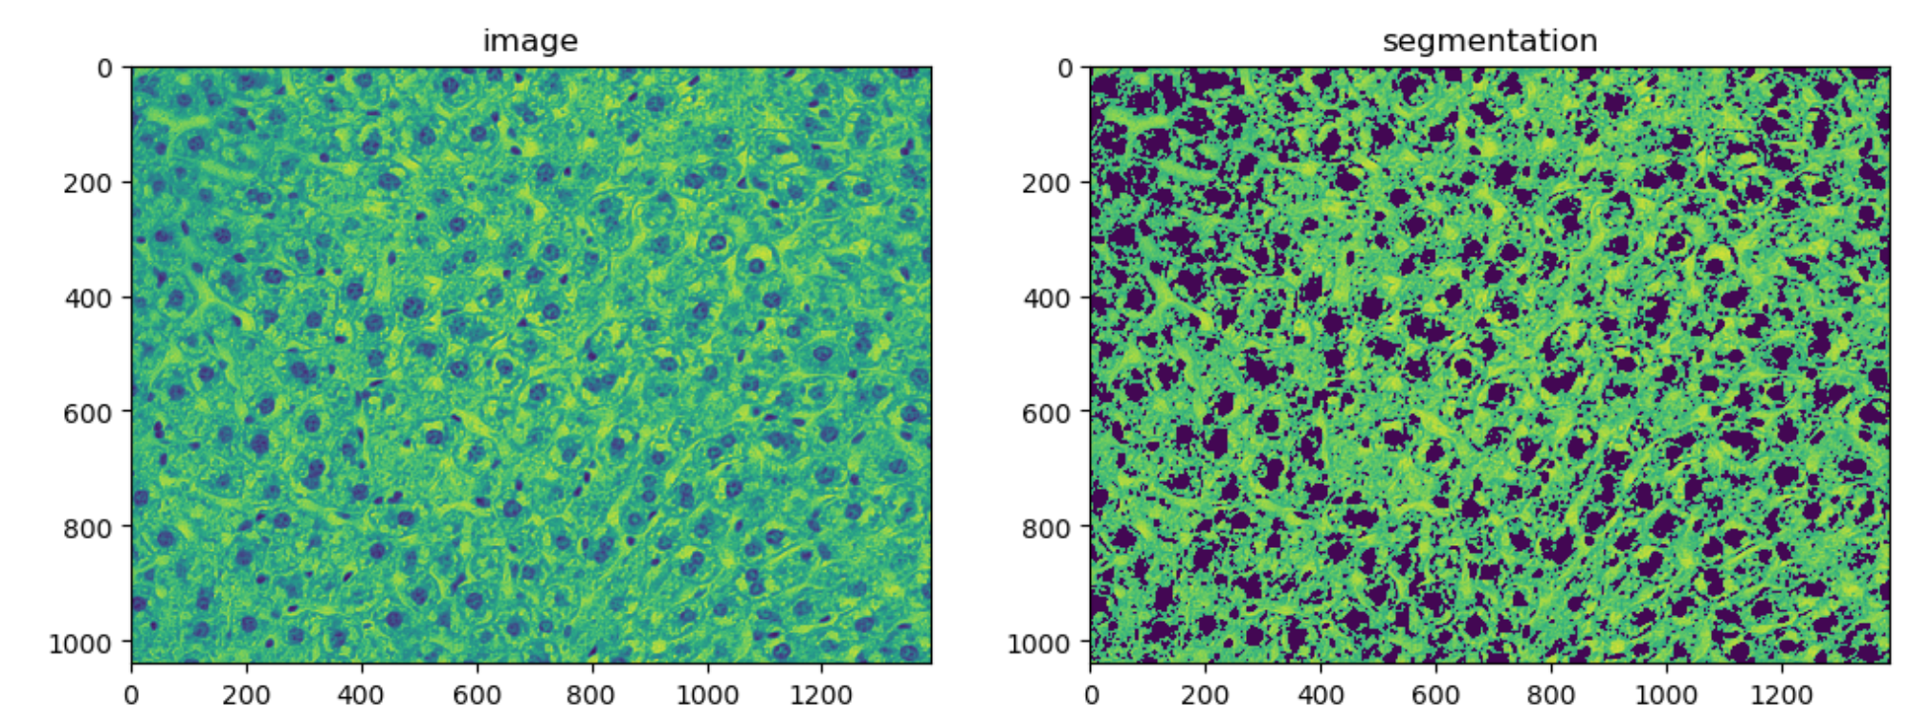
FCM based Nuclei Segmentation
Investment
Benefit
Parameter Name | Parameter Value | Description/ Significance
Clusters | 3 | Number of clusters we expect to see in a given image. In our case, we set this to 3 which gave us the best segmentation result
Epsilon | 0.05 | Sets the stopping condition for the fuzzy c-mean iteration. As long as the difference between the current and the previous iteration is greater than Epsilon, the iteration will continue.
Iterations | 25 | Every iteration results in reduction of “cost” associated with result. Ideally, the cost should be as close as possible to defined epsilon.
Notes:
User decides on number of initial clusters, the stopping condition-epsilon and number of iterations to converge the cost value associated with segmentation to the user defined epsilon. We empicarily found that values of 3, 0.05 and 25 work the best for this dataset.

Slide 14
3. Blob detection
Performed by Scale Space Filtering
Notes:
3. Blob detection - Performed by Scale Space Filtering

Slide 15
Scale Space Filtering
Segmented Nuclei
Create Scale Space
Laplacian Filtering
Blob Detection using Local Maxima
FCM
Convolution with increasing Gaussian blurring allowing detection of larger blobs. A scale space of 100 .
Convolution with Laplacian of Gaussian where high response denote blobs of certain size
Circles with Center at 1.5 sigma
Witkin, A.P., 1987. Scale-space filtering. In Readings in Computer Vision (pp. 329-332). Morgan Kaufmann
Notes:
We are analysing an unknown scene, there is no way to know a priori what scales are appropriate for describing the interesting structures or blobs of nuclei. Hence, the only reasonable approach is to consider descriptions at multiple scales in order to be able to capture the unknown scale variations that may occur.
FCM segmented images are fed into Scale space that uses gaussian blurring to find larger blobs. We use scale space of 100. Then laplacian of gaussian is used to restrict the size of the blob to 20. Finally local maxima of circles centered at 1.5 sigma is extracted giving us the blobs of nuclei.

Slide 16
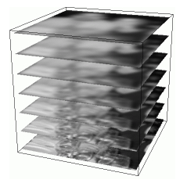
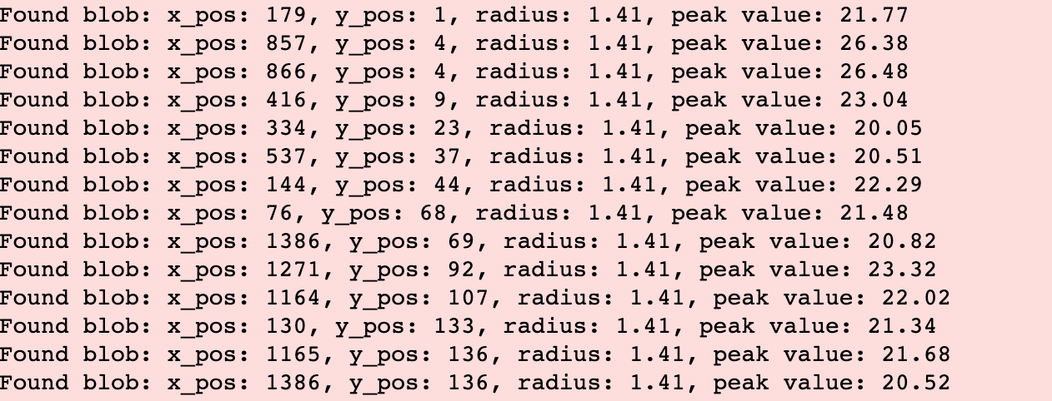
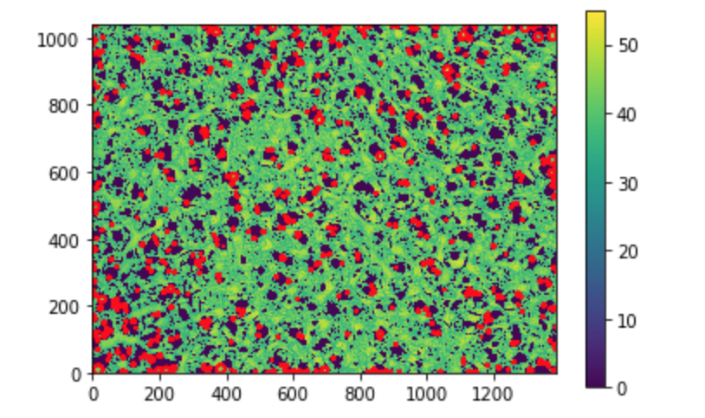
Scale Space Filtering
Investment
Benefit
Creating scale space
Loop through scale space and detect blobs
Prune blobs using local maxima
We set a threshold of 20 across all scales as we were only interested in similar sized blobs (nuclei) rather than a range of blob sizes. For every scale image, detect peaks using the maximum filter technique. All pixel in the neighborhood are set to the maximal value. Peaks are where image = maximum_filter(image)
We created a scale space of 100 to create 100x tiers of the input image for analysis. Setting the scale to 100 gave us the most number of blobs (nuclei) being detected in the slice.
Loop over all pair-wise blob combinations and check for overlapping blobs. If the blobs are overlapping and cross a set overlap area threshold, keep the largest blob
N = 100
Notes:
Created scale space for 100 and a threshold that assumes that all the nuclei will be of similar shape and size, then use local maxima to prune the blobs for checking the overlapping blobs.

Slide 17
4. Feature extraction across blobs and their image slice
Geometric and Texture Features
Notes:
Step 4: Geometric and Texture Features extraction

Slide 18
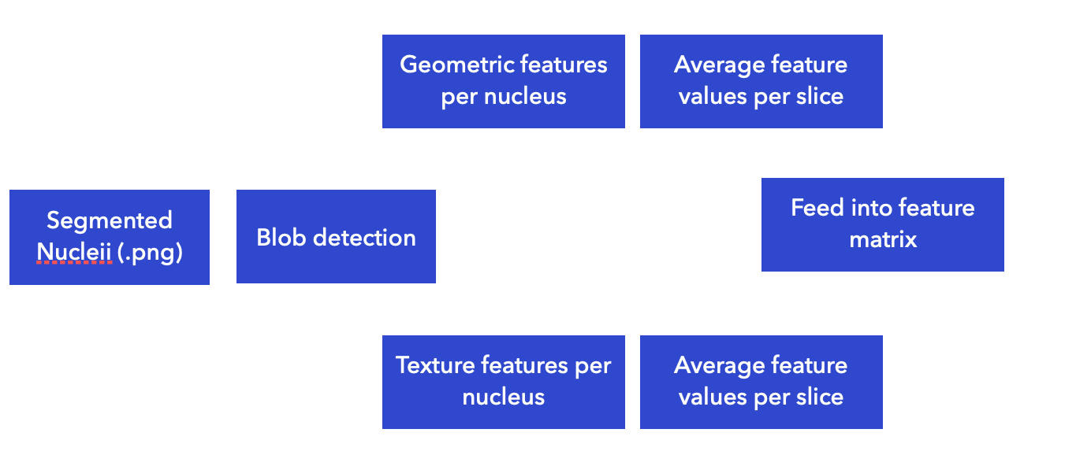
Geometric and Texture Features
Investment
Benefit
Notes:
Geometric and Texture features averaged over every slice is extracted.

Slide 19
Geometric and Texture Features
 | Feature Name | Description
1 | Number of Nuclei | Computed by calculating the number of blobs found in a slice
2 | Number of Overlapping Nuclei | Computed by determining overlap area http://mathworld.wolfram.com/Circle-CircleIntersection.html
3 | Average Area | Total area of all blobs/number of blobs
4 | Average Compactness | Compactness = Area/(perimeter)^2. Average of Compactness across all blobs
5 | Circular blobs | Roundness = 4 *pi* area/(perimeter)^2. If Roundness is 1, blobs is circular
1 | Average Energy | GLCM feature average of energy across image patches created around each blob coordinate
2 | Average Homogeneity | GLCM feature average of homogeneity across image patches created around each blob coordinate
3 | Average Correlation | GLCM feature average of correlation across image patches created around each blob coordinate
All features are
numeric valued
Geometric
Texture
Notes:
4 Geometric and 3 texture features are extracted. Some features are counts and the others are values that are averaged across the slice. All features are
numeric valued

Slide 20
5. Prediction
Machine Learning-Classification
Notes:
Step 5: Prediction is done using classical machine learning

Slide 21
Dataset for Prediction
FCM extracted image segments for all four classes.
It was observed that the segmented images taken from subjects at age of 1 month, seem to contain some spurious values.
All the instances for age 1 month had to be removed.
Notes:
All the instances for age 1 month had to be removed due to spurious values. These values will be investigated further in future work.

Slide 22
Dataset for Prediction
Data set has three NOMINAL target classes: six months, sixteen months and twenty four months.
115 instance in test set from three classes six month, sixteen month and twenty four months. For each class the instances belong to the same mouse.
One leave out 10-fold cross validation was performed on the training set to compensate for low training instances
Model was created and tested on unseen test set (15% ) described in previous slide where all the slices from a mouse where taken.
713 instances in training set from three classes six months, sixteen months and twenty four months

Slide 23
Classifier
Tree based classifier
Instance based classifier
Function based classifier
K-nearest neighbor with cross validation
target outcome determined by majority vote. Value of K=3
Sequential Minimal Optimization (SMO), a faster implementation of support vector machines
C4.5
Pairwise binary classification, final class probabilities predicted using pairwise coupling
Euclidean distance builds data models- compute distances between objects
Note:
WEKA- A Java based machine learning environment was used for prediction
Linear kernel
Modified logistic regression with a ridge estimator to utilize the instance weights.
To predict class membership we use three different classes of classifiers that are known to work well with nominal classes and numeric valued instances.
Notes:
To predict class membership we use classifiers that are known to work well with nominal classes and numeric valued instances.
C4.5-decision tree classifier,
3-nearest neighbor with euclidean distance, AND
sequential minimal optimization (SMO) with linear kernel and modified logistic

Slide 24
Results

Slide 25
FCM based Segmentation
Results:
Good segmentation results were observed in majority of the cases
In some cases, the algorithm did the inverse (created a mask of the background rather than the nuclei). Mask inversion was used in such cases to get correct ROI
Notes:
Good segmentation results were observed
In some cases, the algorithm did the inverse (created a mask of the background rather than the nuclei). Mask inversion was used for correction.

Slide 26
Scale Space Filtering based Blob Detection
The output of Scale Space Filtering based blob detection method was visually acceptable.
Notes:
The output of Scale Space Filtering based blob detection method was visually acceptable.

Slide 27
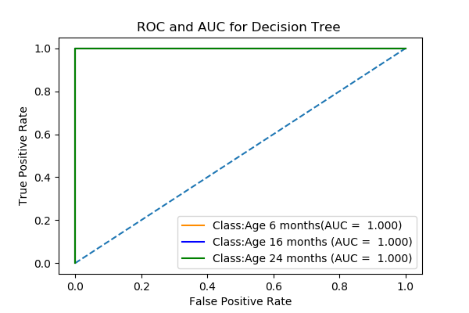
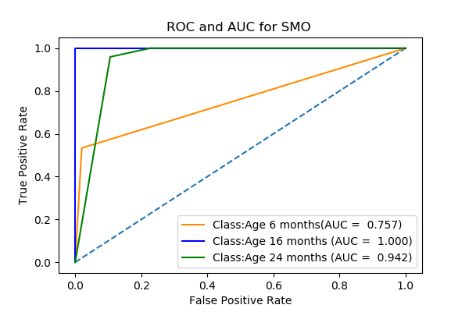
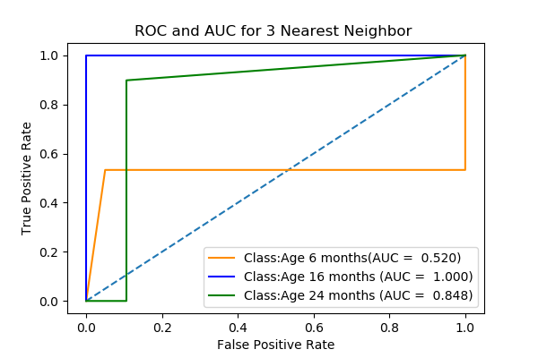
Classification/Prediction Results
Note:
Decision Tree has AUC=1 for all three classes, which means it has good measure of separability
Notes:
Decision Tree has AUC=1 for all three classes, which indicates that for this training-test set decision tree has good measure of separability of classes.

Slide 28
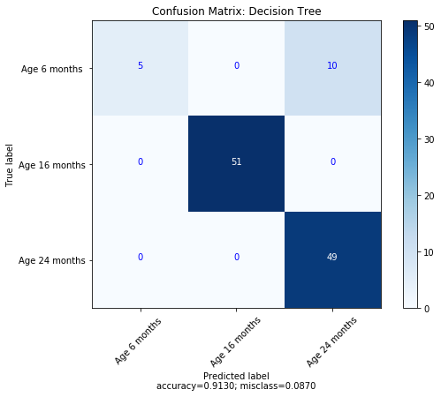
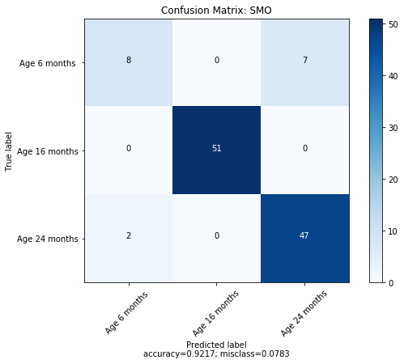
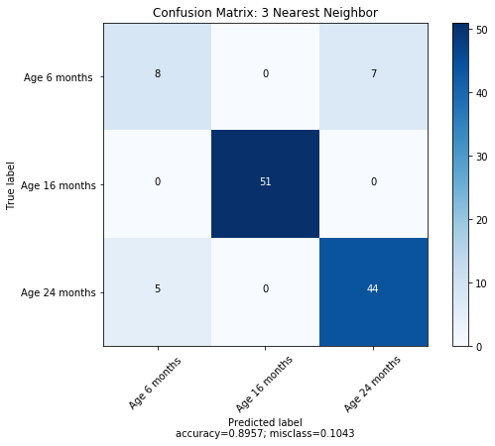
Note:
Decision tree only misclassifies class 6 months.
SMO has the highest accuracy.
OK..Predicted age
(almost)
Notes:
Decision tree only misclassifies class 6 months.
SMO has the highest accuracy.

Slide 29
discussion

Slide 30
Discussion on Error
Note:
Lack of large data sample, restricts the level of error analysis that can be done on the data.
From Confusion matrices it can be seen that largest misclassification is for sample from age 6 months. Considering that FCM and Scale Space data for 1 month was largely spurious, some randomness may be seen for data from 6 months.

Slide 31
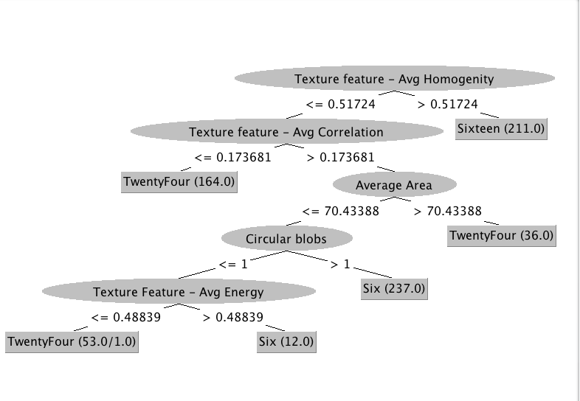
Tree Visualization
Note:
Decision nodes include Texture Features and Geometric Features
Decision nodes can be considered as the interesting biomarkers

Slide 32
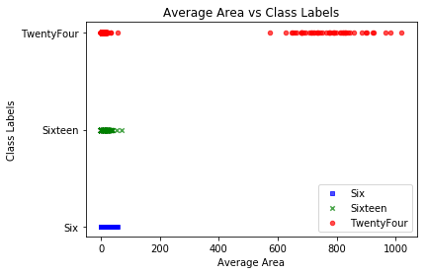
Comparison with Published Work
Cell area has been shown to be statistically significant in describing age related morphological changes in bone marrow derived mesenchymal stromal cells (MSCs)*. We notice that Average Cell Area is one of the decision nodes of decision tree classifier.
Figure below: Notice that Average Cell Area is distinguishing feature between 24 months, and 6 and 16 months.
Indicative that relationship between cell area and age must not be ruled out
Maybe found some biomarkers too
*Oja, S., Komulainen, P., Penttilä, A., Nystedt, J. and Korhonen, M., 2018. Automated image analysis detects aging in clinical-grade mesenchymal stromal cell cultures. Stem cell research & therapy, 9(1), p.6.
Notes:
Indicative that relationship between cell area and age must not be ruled out. Our data supports that too.

Slide 33
Tree Visualization
Note:
Decision nodes include Texture Features and Geometric Features
Maybe found some more biomarkers.. More for future investigation
Decision nodes can be considered as the interesting biomarkers

Slide 34
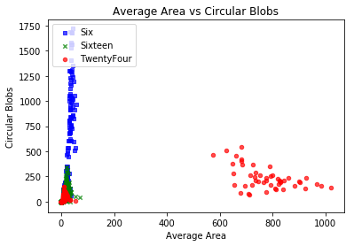
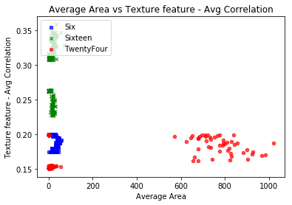
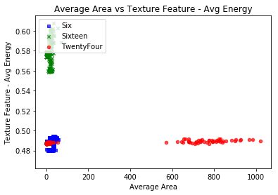
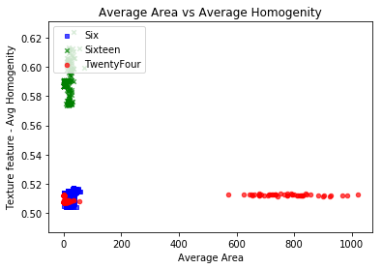
Average Cell Area vs. Other Interesting Features

Slide 35
Summary and Future considerations

Slide 36
Geometric and Texture features from mice liver histology images have been found to be able to predict target class membership of image clusters/blobs derived from FCM based image clustering and Scale Space Filtering based blob detection.
Some of these features need to be investigated further as biomarkers for aging.
There is need for more data that is from diverse sources and is larger in number.
Need to investigate the spurious behavior of images taken at age 1 month.
Notes:
Basically Prediction is acceptable so, there may be a relationship between geometric and texture features extracted from histology images.
Some of these features may be considered as biomarkers of aging.
There is need for diverse data source and increased volume of data to make any conclusions.

Slide 37
References

Slide 38
DATASET:
Zahn, J.M., Poosala, S., Owen, A.B., Ingram, D.K., Lustig, A., Carter, A., Weeraratna, A.T., Taub, D.D., Gorospe, M., Mazan-Mamczarz, K. and Lakatta, E.G., 2007. AGEMAP: a gene expression database for aging in mice. PLoS genetics, 3(11), p.e201.
HISTOLOGY AND AGING:
Oja, S., Komulainen, P., Penttilä, A., Nystedt, J. and Korhonen, M., 2018. Automated image analysis detects aging in clinical-grade mesenchymal stromal cell cultures. Stem cell research & therapy, 9(1), p.6.
FCM:
Chuang, K.S., Tzeng, H.L., Chen, S., Wu, J. and Chen, T.J., 2006. Fuzzy c-means clustering with spatial information for image segmentation. computerized medical imaging and graphics, 30(1), pp.9-15.
SCALE SPACE FILTERING:
Witkin, A.P., 1987. Scale-space filtering. In Readings in Computer Vision (pp. 329-332). Morgan Kaufmann
Notes:
Some of the references are listed here.

Slide 39
‘The future cannot be predicted. The best way to cope with the future is to create it.’
Dennis Gabor, Nobel Prize winner: Physics

