Slide 1
Beyond Genomics: IR based Computational Proteomics
Sumi Singh
1/16/2015

Slide 2
Outline
Overview
Introduction
Proteomics: The Nature
Proteomics: The Science of Modeling the Nature
Proteomics: Computation
Testing of Model and Computational Methods
Prediction and Discovery
Protein Structure Search Tool
Place of IR in Cybersecurity
Future Work
Conclusion

Slide 3
OVERVIEW

Slide 4
Overview
Bioinformatics → Proteomics
Information Retrieval
Cybersecurity
Data Mining

Slide 5
INTRODUCTION

Slide 6
Information retrieval, data mining and databases
 | INFORMATION RETRIEVAL | DATABASES | DATA MINING
System provides | Pointer to data | Data item | Data Characterization and discovery
User query | General | Specific | No query
Retrieval methods | Probabilistic, heuristic | Deterministic, correct | Probabilistic, approximate
Criteria for success | Utility | Efficiency | Predictive accuracy
Structure | Unstructured | Structured | Semi structured
Examples | Search engines | RDBMS | Business analytics

Slide 7
Bioinformatics
Bioinformatics
Genome analysis
Structure analysis
Sequence analysis
Process analysis
Epigenetics
Others
Structure prediction
RNA Structure comparison
Structure comparison
Protein structure comparison

Slide 8
Genome analysis and computer science
Explosion of genomics data
Computer science is playing a central role in genomics
Sequencing and assembling of DNA sequences
Analyzing genomes to locate genes
Similarities between sequences of different organisms
Computational genomics
Applications of older methods
Development of novel algorithms for the analysis of genomic sequences.
Entire DNA sequences of several organisms, including human, are now available.

Slide 9
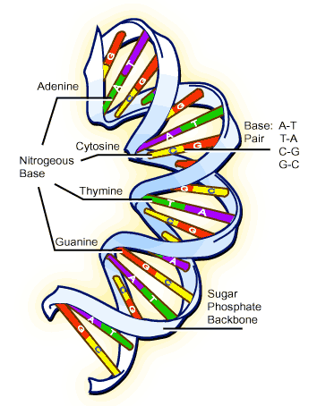
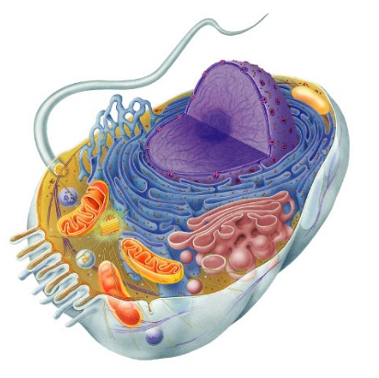
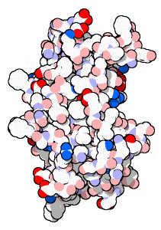
DNA → Proteins → Cells → Bodies
DNA has the information to build proteins
A cell is primarily made of proteins
Proteins make cells functional
Bodies are made up of cells
DNA
proteins
cells
bodies
DNA gets all the glory,
Proteins do all the work
Source: Regent biology

Slide 10
Human proteome project
Map protein-based molecular architecture of the human body
A resource to advance diagnosis and treatment of diseases like Alzheimer's, Diabetes, Cancer ….
Duration
2012-2022

Slide 11
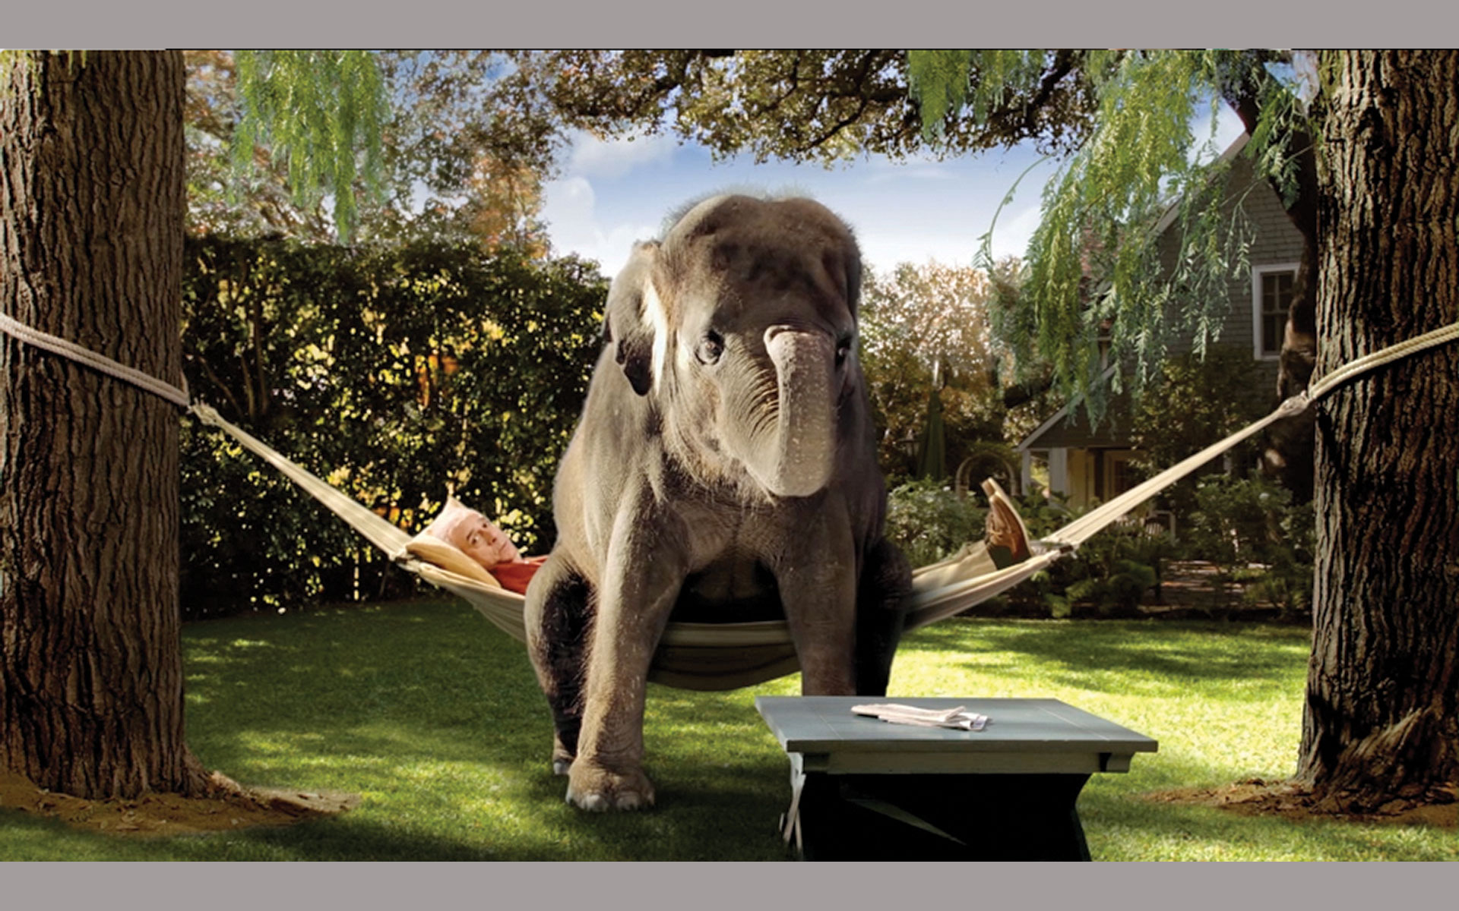

Personalized Medicine and Personal Proteome
No generic, full of side effect treatments
Highly personalized
Minimal side effect
Safe
Cost effective
Environmentally friendly treatment

Slide 12
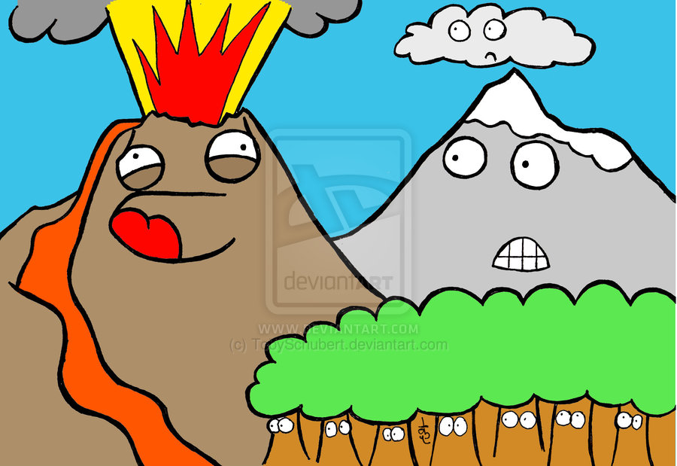
Computational needs in personal proteomics
Data collection
Data analysis
Storage
Availability
Security
Usability
Integrity
Personal genome sequencing for $1000
100 GB/ person
Personal proteome
100 GB +++?/person
DATA
Image Source: Tony Schubart

Slide 13
Proteomics
Nature
Science
Computation

Slide 14
NATURE
PROTEINS AND THEIR STRUCTURE

Slide 15
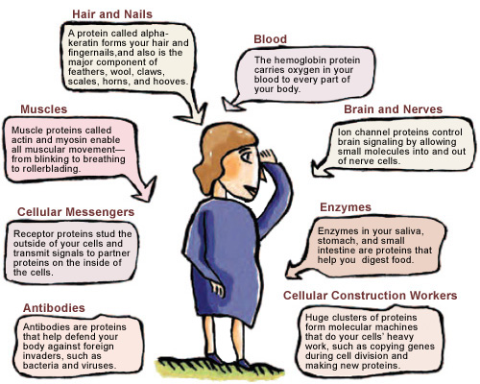
Proteins are worker molecules

Slide 16
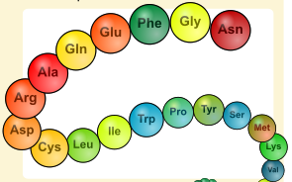
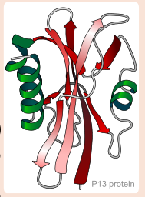
Protein: Sequence and Structure
FOLDS INTO 3D STRUCTURE
AMINO ACID SEQUENCE
3D STRUCTURE
Proteins are made of amino acids hooked end-to-end like beads on a necklace
To become active, proteins must twist and fold into their final conformation.
Image Source: Wikipedia

Slide 17
Structural basis of protein function
Protein structure largely determines protein function.
By studying the structures of proteins, we are better able to understand how they function normally and how some proteins with abnormal shapes can cause disease.
Notes:
Why is it useful..

Slide 18
Natural structural hierarchy
Structurally most distant
Class
Fold
Superfamily
Family
Called Distant Homologues with significant structural similarity
Structurally
Most similar. Called HOMOLOGUES
May be functionally similar
Based on Physio-Chemical properties

Slide 19
Natural functional clusters
Class
Fold
Superfamily
Family
Extremely Difficult to find Functional Clusters
Most Common Protein Hierarchy
Local Structural Differences
Structurally Conserved Local Motifs across Several Proteins

Slide 20
SCIENCE
MODELS FOR PROTEIN STRUCTURE AND FUNCTION

Slide 21
x, y, z coordinates
(x, y, z) coordinates for every atom
X-ray diffraction method
Nuclear magnetic resonance method
Computational (prediction)

Slide 22
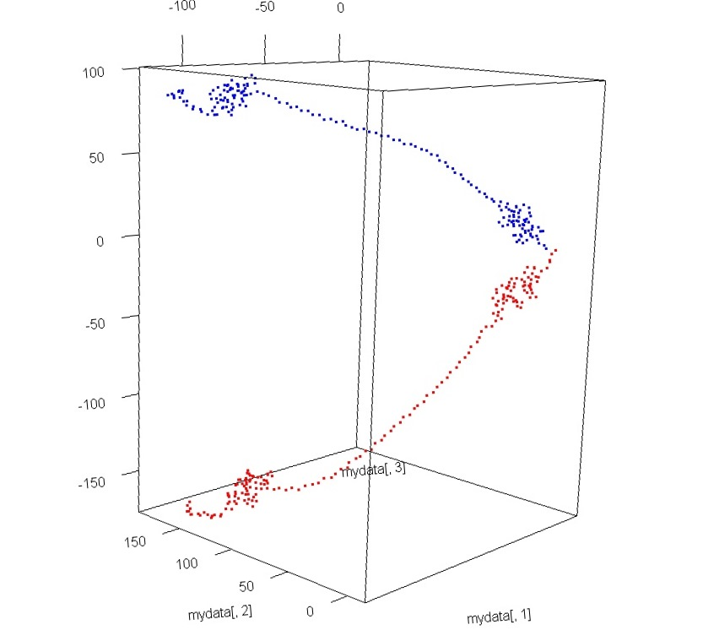
Limitations of coordinate assignment methods
PDBID:1b8t chain A NMR model 1
Lack of common frame of reference
Same protein, two experiments, two sets of coordinates
Need for Structural Alignment before comparison
PDBID:1b8t chain A NMR model 10

Slide 23
Protein structure comparison using structural alignment
Translation
Additional
Computation Cost
Rotation
Rotation
Lack of good alignment
Global alignment does not mean good local alignment

Slide 24
SCIENCE
CHALLENGES WITH ALIGNMENT

Slide 25
The inversion problem
Struct1
Struct2
Struct2 is created by reversing Struct1.
Same amino acids, same (x, y, z) coordinates, same length
Must result in 100% alignment
Maximum of 71% alignment was achieved using standard protein alignment based method

Slide 26
Lack of sequence information
FOLD INTO 3D STRUCTURE
AMINO ACID SEQUENCE
3D STRUCTURE
Images: Courtesy Wikipedia

Slide 27
Lack of scale sensitivity
Similar structures but different functions

Slide 28
SCIENCE
NEED FOR ALIGNMENT FREE COMPARISON METHODS

Slide 29
Alignment free comparison algorithm
Structural representation of “Unit”
Hash function for transformation of “Unit”
Sequence representation of “Unit”
Structural “Unit”
Propose:
Spatial Relationship based Structural Hashing

Slide 30




“Unit” in 3D
All possible combinations of three amino acids present in the sequence (TRIPLE).
Each amino acid in the triple are represented by the x,y,z coordinates of their respective centroids.
$$H$$
$${NH}_{3}^{+}$$
Centroid
$${COO}^{−}$$
Centroid(x,y,z) of 3rd amino acid of triple
$$R$$
Centroid(x,y,z) of 1st amino acid of triple
Centroid(x,y,z) of 2nd amino acid of triple
Notes:
X,y,z coordinates for Centroid of amino acids are represented by c-alpha atom

Slide 31
Sequence representation
Proteins are a sequence of amino acids
Numeric codes for amino acids
a₁, …,a₂₀∈ AminoAcid → A
l₁, l₂, l₃, .., l₂₀ ∈ Z⁺
F : A → Z⁺
Continuous
Unique
∈ Z⁺
Centroid(x,y,z) of
Label3
The numeric CODES assigned to amino acids are called LABELS
Centroid(x,y,z) of
Label1
Centroid(x,y,z) of
Label2

Slide 32
Structural representatives
Label₃
d13
d23
Angle (θ)
formed by the line from centroid of amino acid represented by Label₃
to the opposite side and the corresponding length d12
θ
Label₁
d12
Label₂
Representative Length (D)

Slide 33

Quintuple of Variables
Represents the “UNIT” or amino acid triple
Its Structure
Its Sequence
$$\{{Label}_{1}, {Label}_{2}, {Label}_{3}, θ, D\}$$
Label₃
d13
d23
θ
Label₁
d12
Label₂
Representative Length (D)

Slide 34
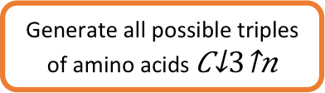


Spatial Relationship based Structural Hashing
Numeric codes for amino acids
Generate all possible triples of amino acids $C_{3}^{n}$
Transformation from Amino Acid Names to LABELS
Represented by the (x, y, z) of centroid of each amino acid
Perform rule based label arrangement
Label₃
d13
d23
Calculate Angle and Length
$$\{{Label}_{1}, {Label}_{2}, {Label}_{3}, θ, D\}$$
θ₁
Quintuple
Label₁
d12
Label₂
Calculate Key/triple
$$k=f_{3D}^{s}(QUINTUPLE)$$
Representative Length (D)

Slide 35

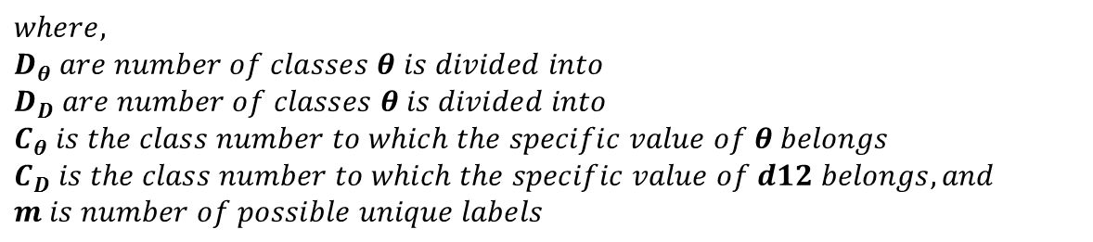

The “Function”?? Add the equation
$$k=f_{3D}^{s}(QUINTUPLE)$$
$$k=D_{θ}D_{D}\left({Label}_{1}−1\right)∗m^{2}+D_{θ}D_{D}\left({Label}_{2}−1\right)∗m+D_{θ}D_{D}\left({Label}_{3}−1\right)+D_{D}\left(C_{θ}−1\right)+\left(C_{D}−1\right)$$
$$where,$$
$$D_{θ} are number of classes θ is divided into$$
$$D_{D} are number of classes θ is divided into$$
$$C_{θ} is the class number to which the specific value of θ belongs$$
$$C_{D} is the class number to which the specific value of d12 belongs, and$$
$$m is number of possible unique labels$$
Key (k) is calculated for all possible triples ($C_{3}^{n}$),
where n=amino acids in the protein.
Notes:
N choose three

Slide 36
Properties of the “Function”
Function $f_{3D}^{s}$ is deterministic
Function 𝒇_𝟑𝑫^𝒔 is deterministic
Key $f_{3D}^{s}$(Quintuple) is scale sensitive
Key 𝒇_𝟑𝑫^𝒔(Quintuple) is scale sensitive
Key $f_{3D}^{s}$(Quintuple) is rotation and translation invariant
Key 𝒇_𝟑𝑫^𝒔(Quintuple) is rotation and translation invariant
Solves the inversion problem

Slide 37
Hashing --> Binning
Binning of Representative Length and Representative Angle.
An iterative and adaptive binning algorithm is proposed to prevent inconsistency in bin assignment and optimized to reduce intra bin variance while maximizing similarity.

Slide 38
COMPUTATION
PROTEIN STRUCTURE COMPARISON

Slide 39
Computational steps
Global similarity among protein structures
Structural classification of proteins
Local functional clusters and motifs
Structural key generation using Structural Relationship based Hashing

Slide 40
Key generation
Key Generation
$$k=D_{θ}D_{D}\left({Label}_{1}−1\right)∗m^{2}+D_{θ}D_{D}\left({Label}_{2}−1\right)∗m+D_{θ}D_{D}\left({Label}_{3}−1\right)+D_{D}\left(C_{θ}−1\right)+\left(C_{D}−1\right)$$
Convert
Key- value pair for all proteins

Slide 41
COMPUTATION
GLOBAL SIMILARITY

Slide 42
Protein 3D structures and its significance
Structural similarity between two proteins means functional similarities
Predict binding site
Predict drug interaction
Drug design
Drug delivery
Pharmacophore design
Substrate interaction
Metabolic pathways
Disease pathways
Notes:
Why is it useful..

Slide 43
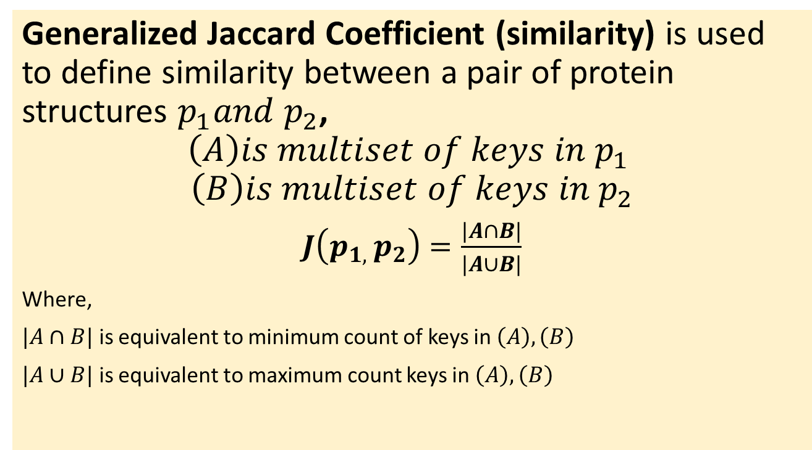
Statistical measure of the similarity
Generalized Jaccard Coefficient (similarity) is used to define similarity between a pair of protein structures $p_{1}and p_{2}$,
$$\left(A\right)is multiset of keys in p_{1}$$
$$\left(B\right)is multiset of keys in p_{2}$$
$J\left(p_{1, }p_{2}\right)=\frac{|A∩B|}{|A∪B|}$
Where,
$|A∩B|$ is equivalent to minimum count of keys in $\left(A\right),\left(B\right)$
$|A∪B|$ is equivalent to maximum count keys in $\left(A\right),\left(B\right)$

Slide 44
COMPUTATION
CLASSIFICATION

Slide 45
Protein structure hierarchy
Class
Fold
Superfamily
Family

Slide 46
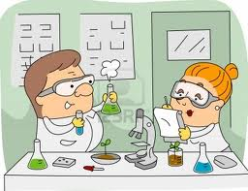
Importance of protein classification
Proteins have natural structural hierarchy.
When a new protein is discovered and its structure decoded, finding its position in the hierarchy becomes interesting immediately.
Biochemical experiments are expensive, computational methods come handy.

Slide 47
Challenges with protein classification
Multinomial classification
Hierarchical classification
Large number of labels

Slide 48
Multinomial hierarchical classification
hierarchy
Multinomial
Class
There are 7 natural labels (a, b, c, d, e, f, g)
Fold
Each Class has at least 90 distinct Folds
Super Family
Each Fold can have from 1 to 100s of Super Family
Family
Each Super Family can have from 1 to 100s of Family

Slide 49
Multinomial hierarchical classification
One vs. One classifier ensemble for Multinomial to Binomial Reduction
Label fusion for reducing large number of labels
One vs. One classifier ensemble per label all child (PLAC) trained for hierarchical classification

Slide 50
Ensemble learning
One vs. One Classifier
Pairwise classifiers for all possible label pairs
Trains K (K − 1) / 2 classifiers (K=number of labels)
Prediction based on a voting scheme

Slide 51
Label fusion
One vs. one classification can result in extremely large number of classifiers if there are too many labels.
Decompose the problem into smaller number of labels by fusing several labels into one.
Alpha Beta Alpha or Beta Alpha and Beta …
Labels are fused into two groups
: : : :
Fold_1 Fold_2 Fold_3 Fold_4
Group 1
Group 2
Binomial Classification
Fold_1 Fold_2
Binomial Classification

Slide 52
Why label fusion?
 | a | b | c | d | e | f | g
Number of folds | 285 (folds) | 176 (folds) | 148 (folds) | 380 (folds) | 68 (folds) | 57 (folds) | 91 (folds)
Fusion (fold) 1 into groups (max 10 labels per group) | 29 | 18 | 15 | 38 | 7 | 6 | 10
Fusion (fold) 2 into groups (max 10 labels per group) | 3 | 2 | 2 | 4 | 2 | 2 | 2
Classifier after fusion (fold) | 13,500 | 810 | 315 | 18,000 | 3,171 | 2,700 | 4,500
Classifier before fusion (fold) | 40,470 | 15,400 | 10,878 | 72,010 | 2,210 | 1,596 | 4,095

Slide 53
One vs. One ensemble per label all child
Alpha Beta Alpha or Beta Alpha and Beta …
Classifier 1
Feature selection 1
: : : :
Fold_1 Fold_2 Fold_3 Fold_4 …..
Classifier 2
Feature selection 2
Classifier 3
Feature selection 3
SF_1 SF_2 SF_3 …
: : : :

Slide 54
COMPUTATION
Local functional clusters and motifs

Slide 55
Functional clusters
Class
Fold
Superfamily
Family
Extremely Difficult to find Local Functional units
Most Common Protein Hierarchy
Local structural difference
Structurally conserved local motifs

Slide 56
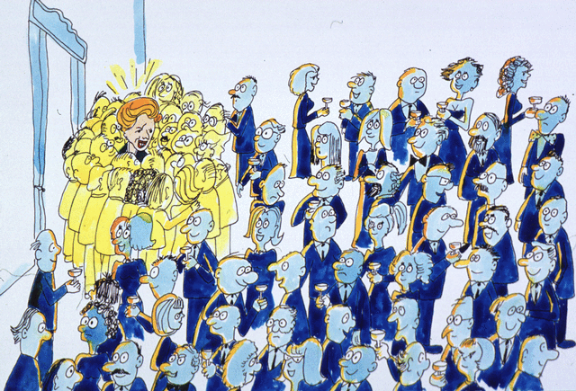
Functional clusters
The representation of these special sub-structures using Spatial Relation Based Structural Hashing was found to have Low frequency deviation, so selection of structural features based on Mean absolute deviation is made.

Slide 57
Model + Computation
Model testing
Prediction
Structural Relationships based Hashing for protein structure modeling
Discoveries
Search tool

Slide 58
MODEL TESTING

Slide 59
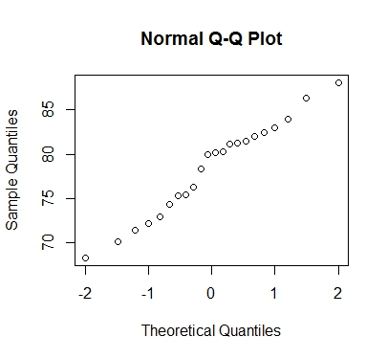
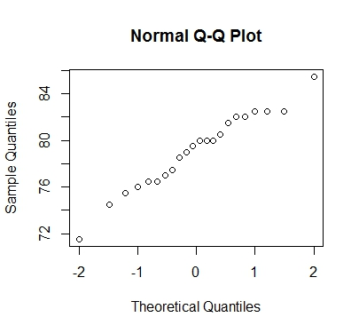
Compare ranked similarity output with alignment based method
Test of normality for pairwise similarity calculated using Jaccard Coefficient
Test of normality for pairwise similarity calculated using FATCAT method

Slide 60
Compare ranked similarity output with alignment based method
R output:
Welch Two Sample t-test
p-value = 0.5985
Null hypothesis:
True difference in means is equal to 0
Alternative hypothesis:
True difference in means is not equal to 0
Conclusion:
We cannot reject null hypothesis as p-value>0.05

Slide 61
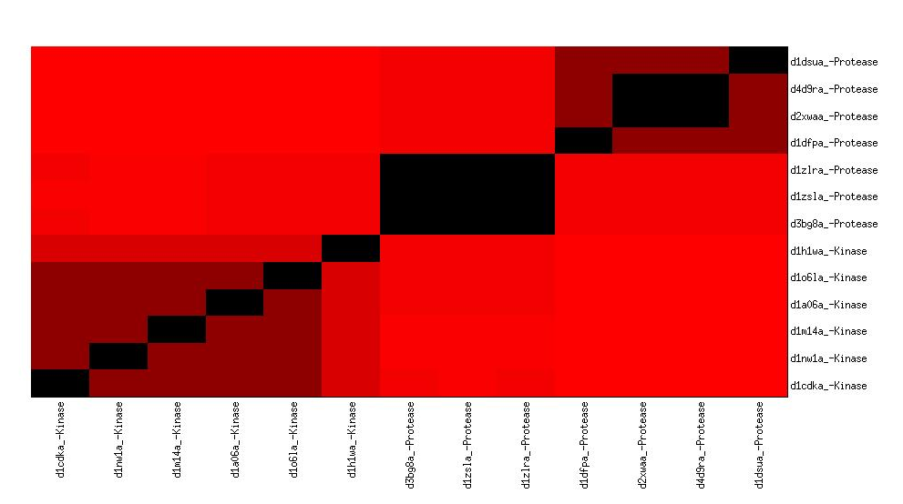
Distinguishing power of Structural Relationship based Hashing
Group Protease
Group Kinase

Slide 62
Classification accuracy
At class level 85% accuracy
ALPHA
BETA
ALPHA & BETA
ALPHA or BETA
SMALL
MULTI
MEMBRANE
Fold
92 %
98 %
91 %
70%
86 %
87%
93 %
SF
79%
81%
86%
92%
74%
80%
85%
Standard/ benchmark (Ding Dubchack) data set with 600 instances in training and 600 in testing.

Slide 63
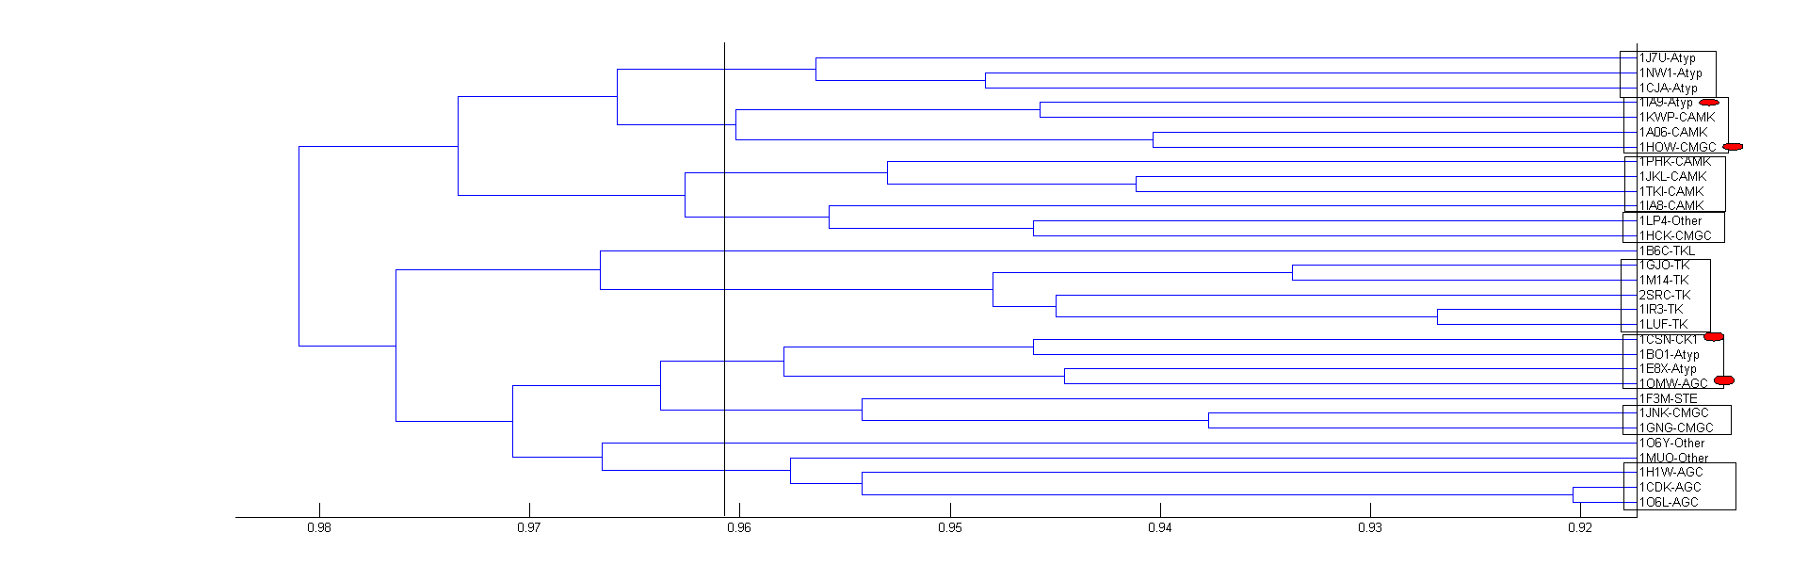
Functional clusters
36 out of 40 human kinases are clustered correctly

Slide 64
PREDICTION AND DISCOVERIES

Slide 65
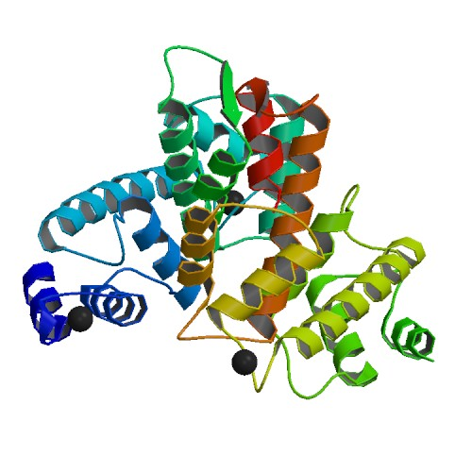
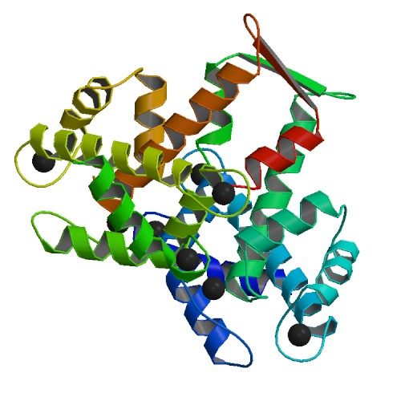
Classification-Prediction of unknown protein
1k94 a human protein was chosen for testing the classification-functional prediction model
Predicted as Ca2+ ion binding functionally similar to another protein found in E-Coli
Human
E-Coli

Slide 66
Finding local similarity
Finding STRUCTURAL MOTIFS in kinases
Notes:
Keys of same motifs will differ only on most two significance values. D= aspartic acid, G=glycine, F=phenylalanine

Slide 67
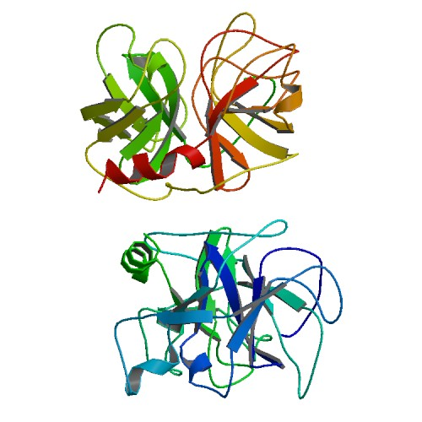
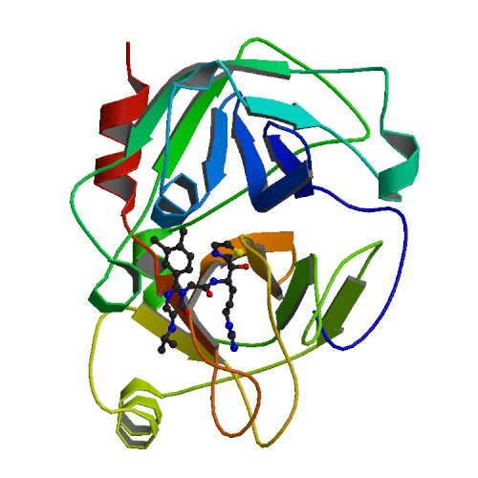
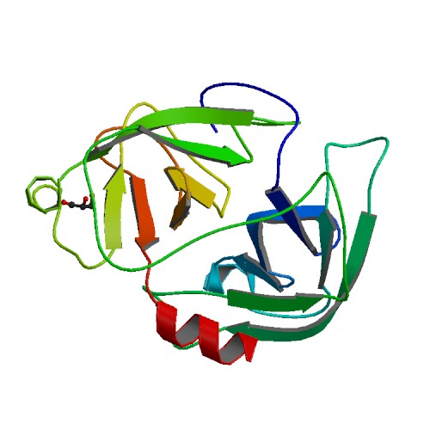
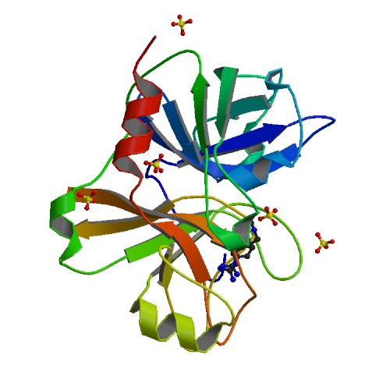
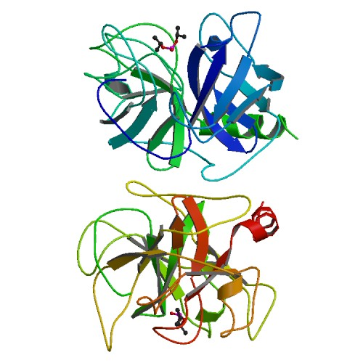
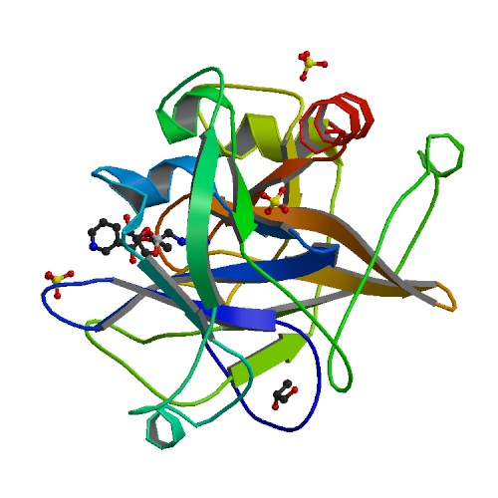
Predicting local functional group in Protease
1dsu
3bg8
Factor XI
Factor D
2xwa
1zsl
1dfp
1zlr

Slide 68
PROTEIN STRUCTURE SEARCH TOOL

Slide 69
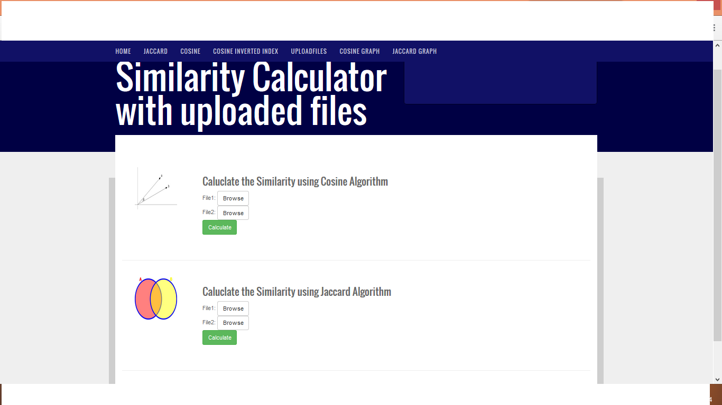
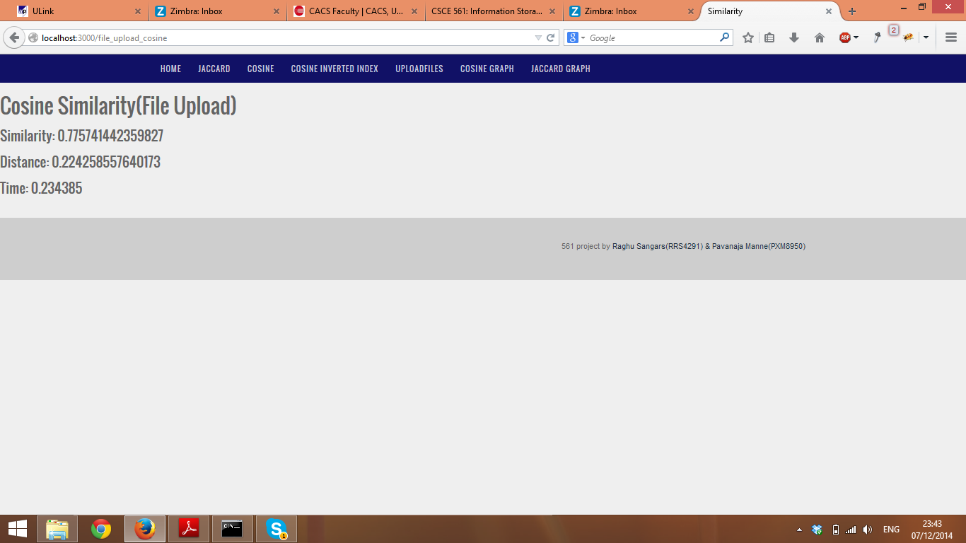
Pairwise similarity calculation

Slide 70
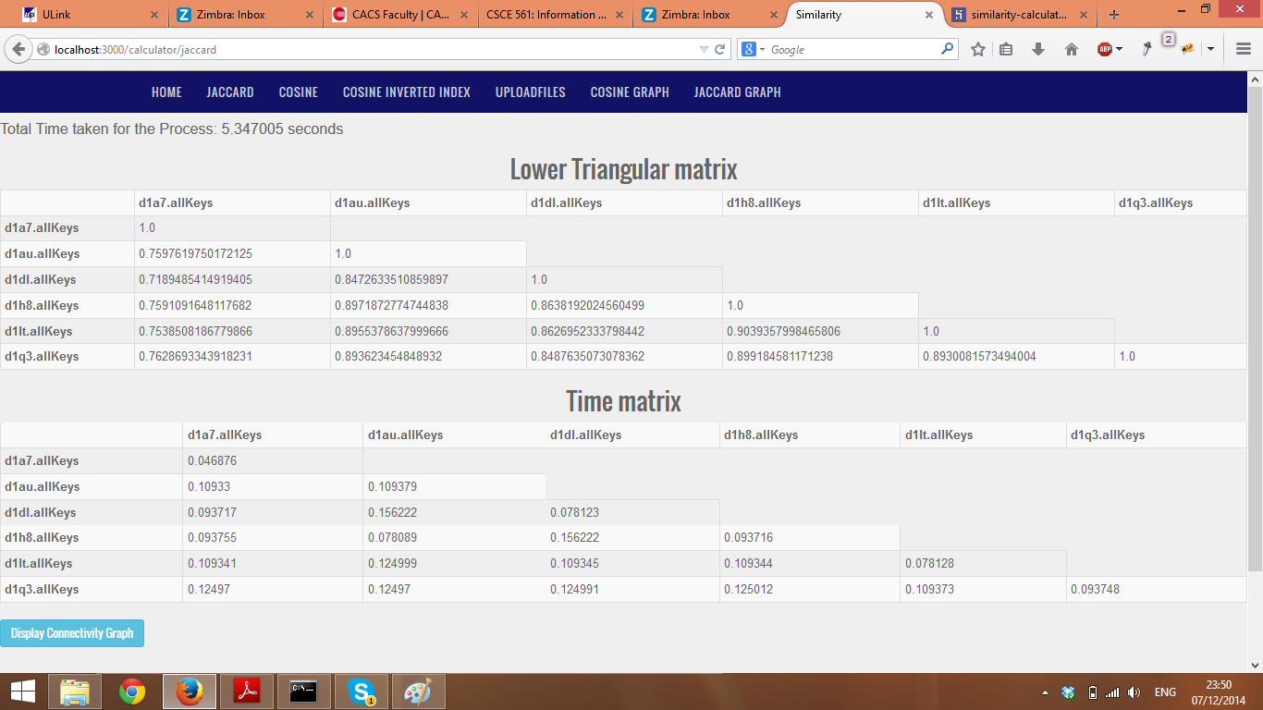
Multiple proteins similarity calculation

Slide 71
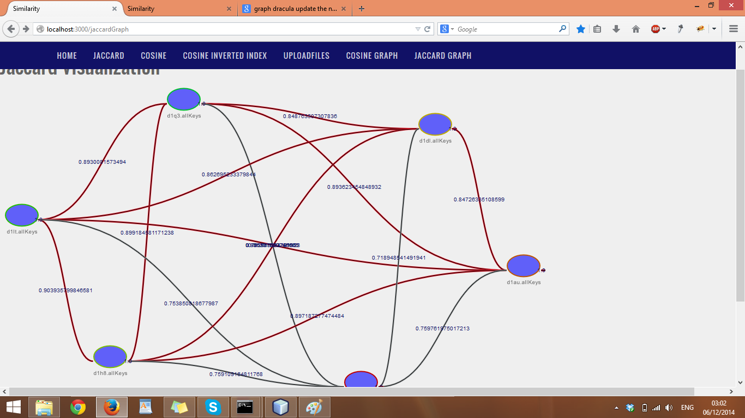
Structural connectivity map

Slide 72
INFORMATION RETRIEVAL IN MALWARE ANALYSIS

Slide 73
IR in Cybersecurity
IR systems
Malware analysis
Network log analysis
Cryptanalysis

Slide 74
Approaches to malware analysis
Malware Analysis
Static Program Analysis
Information Retrieval
Machine Learning
Behavioral Analysis

Slide 75
Traditional malware analysis
Disassembly
Convert executable to assembly code
Control Flow Analysis
Construct control flow graph
Data flow Analysis
Identify malicious code
Procedure Analysis
Identify procedure boundaries

Slide 76
IR-based malware analysis
Disassembly
Convert executable to assembly code
Text Feature Extraction
N-grams
Feature Weighing
Term Frequency
N-mers
N-perms
TFIDF
Document Frequency
Construct Classification Model
SVM
Decision tree
Neural Nets

Slide 77
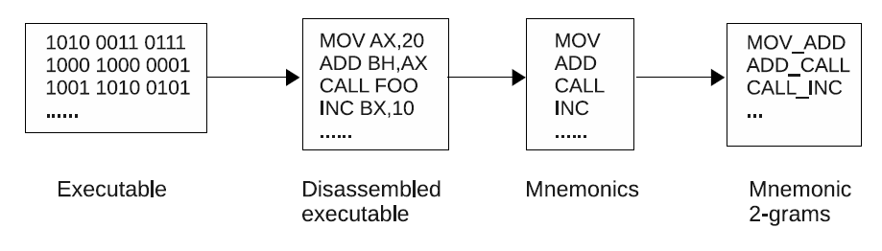
Text feature extraction and weighting
Intuition: Extract and weigh features to identify more discriminating instructions
Features:
  Mnemonic N-grams
Weights
  TF: Normalized Term Frequency
  IDF: Inverse Document Frequency
  TFIDF = TF*IDF
    IDF weighs down more commonly occurring features

Slide 78
Traditional method vs IR method
Traditional methods
Time consuming
Obfuscation methods break the pipeline
IR-based systems
Need for manual interaction
Efficient
Adaptive to obfuscation methods
Completely automated

Slide 79
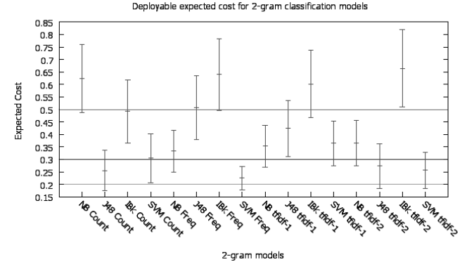
IR models and their expected cost of deployment

Slide 80
FUTURE WORK

Slide 81
Domain specific search engines
Ranked output engines
Page Rank
Protein Rank
Malware Rank
Gene Rank

Slide 82
Link discovery in social networks
Discover user preferences based on Link analysis
Provide heuristics for adword auction algorithms
Better recommender systems

Slide 83
Flu progression prediction
Apply link analysis to predict flu perimeter
Use patient database network
Use city and county records
Current methods for CDC predictions
Low accuracy
Based on reported incidents

Slide 84
Conclusion
Proteomics is the next frontier in medicine
  Computational methods central to unraveling the human “Proteome”
  IR-based methods successfully applied to protein 3D structure prediction
Similar IR based approaches applied in
  Cybersecurity
  Social media knowledge discovery
Can be brought to classroom as following courses
  Search engines
  Bioinformatics
  Social network analysis

Slide 85
Thank you

