Slide 1
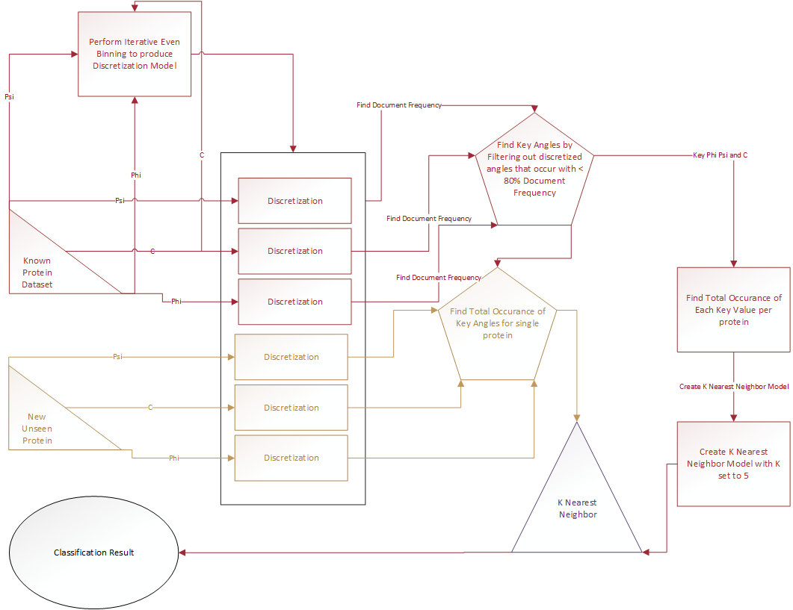
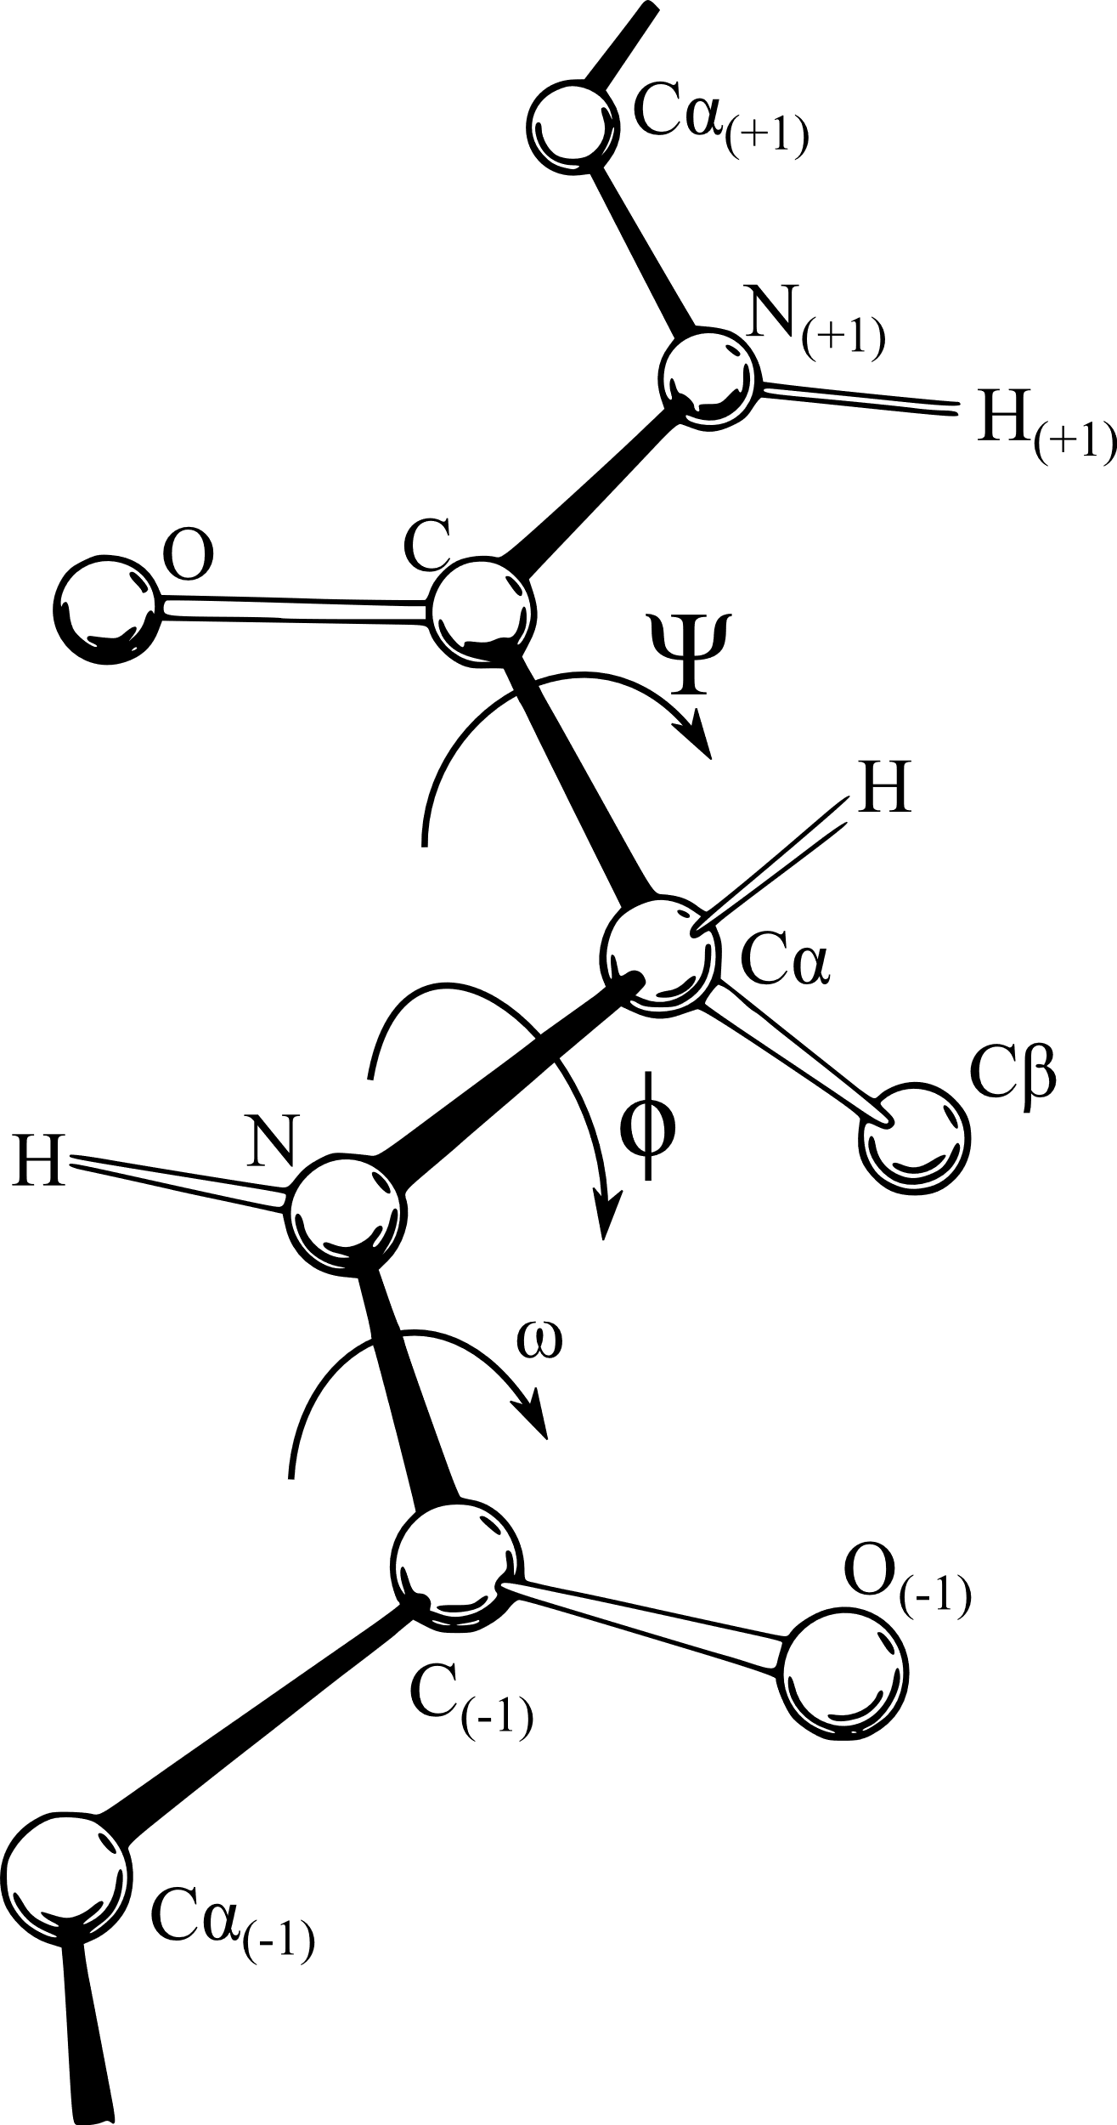
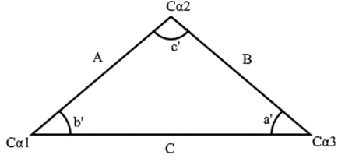
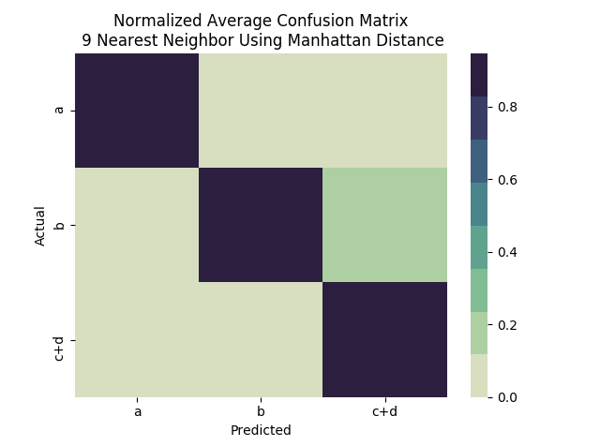
Protein Structural Domain Prediction
Based on Dihedral and Geometric Angles
Joshua Herndon, Sumi Singh, PhD
Department of Computer Science and Mathematics
University of Central Missouri
Introduction
Angle Calculation and Discretization
Comparison of protein structures has a significant place in computational and structural biology. It has paved a way to elucidate the relationship between proteins with respect to their structural, functional and evolutionary properties [1]. Owing to the increase in number and complexity of protein structures, the scope for novel and efficient methods to compare protein structures are at large.
The three dihedral angles or torsion angles in proteins can be defined as the internal, rotational angles around the N-Cα bond (ϕ or Phi), the Cα-C bond (ψ or Psi) and the C-N bond (ω or Omega) [2, 3].0 These torsion angles are crucial in determining the backbone structure of a protein.
Due to the fact that torsion angles specify the three-dimensional spatial arrangement of a protein backbone, they are used in some protein structure comparison methods [5].
All protein structure comparison methods involve three important steps:
(i) Detection of structural similarities
(ii) Structural alignment based on the similarities
(iii) Statistical validations
In the traditional comparison methods, distances between selected sets of points, usually, Cα atoms or secondary structure elements are measured. Most of these distance matrix methods do not consider the flexibility of protein structures in a three-dimensional space [6]. This problem can be addressed by using a torsion angle representation in which the protein
This newly presented framework is based on protein backbone angles, using a combination of nearest neighbor and extreme value deviation. The structural representatives are the combination of two torsion angles ϕ and ψ , and geometric angle C (the geometric angles formed between Cα atoms of three consecutive amino acids used for torsion angles).
The dihedral angles ψ and ϕ are calculated using the torsion angle formula:
$torsion angle=\cos^{−1}\left(−\frac{n_{A}∙n_{B}}{\left|n_{A}\right|\left|n_{B}\right|}\right)$ (1)
where
$n_{A}=\left(p2−p1\right)x\left(p2−p3\right)$ (2)
$n_{B}=\left(p2−p3\right)x(p4−p3)$ (3)
Angle “C” is calculated using the following:
$Angle C=\cos^{−1}{(\frac{A^{2}+B^{2}+C^{2}}{2AB})}$ (4)
Where, A is the length between the first alpha-carbon and the second alpha-carbon, B is the length between the second alpha-carbon and the third alpha-carbon, and finally C is the length between the third alpha-carbon and the first alpha-carbon
The three angles, ϕ, ψ, and c, are discretized using an iterative adaptive binning technique described below:
For a random sample, a majority of the normalized pairwise similarities will be less than 0.5. This can used to associate a z-score to the similarity value and use that estimate the overall similarity between a protein pair, following Extreme Value Distribution.
[Fig d: Process used for discretization and classification]
Results and Conclusion
[Backbone Torsion Angles, Jane S Richardson,
Creative Commons 3]
torsion angles, specifically, ϕ and ψ angles are used in combination with or without other structural representation [7]. Some previously used methods include Dihedral transformation method [8], Dihedral transformation based on partition of space [9], Structure alignments using torsion angles [4], Torsion Angle Alignment [7], and Combination of torsion angle and distance method [5].
It has been shown that the structural and sequence similarities follow Extreme Value Distribution (EVD) [3,7].
For a value x, that is not completely in the bin i, if
[1] S. Srivastava, Lal, S. B., Mishra, D. C., Angadi, U. B., Chaturvedi, K. K., Rai, S. N., and A. Rai, “An Efficient Algorithm for Protein Structure Comparison Using Elastic Shape Analysis,” Algorithms for Molecular Biology : AMB, 11:27, 2017.
[2] S. Jung, S-E. Bae and H.S. Son, “Validity of Protein Structure Alignment Method Based on Backbone Torsion Angles,” J Proteomics Bioinform 4: 218-226, 2011.
[3] Jiangning Song, Hao Tan, Mingjun Wang, Geoffrey I. Webb and Tatsuya Akutsu, “TANGLE: Two-Level Support Vector Regression Approach for Protein Backbone Torsion Angle Prediction from Primary Sequences,” PLoS One 7(2): e30361, 2012.
[4] S. Jung, S-E. Bae, I. Ahn and H.S. Son, “Protein Backbone Torsion Angle-Based Structure Comparison and Secondary Structure Database Web Server” Genomics & Informatics, 11(3), 155–160, 2013.
[5] Dobrinka Petrova, “Protein structure comparison based on distances between secondary structure elements and backbone dihedral angles,” in Proc. 12th International Conference on Computer Systems and Technologies (CompSysTech’11), Ruse, Bulgaria, Jun. 2011, pp. 359-364.
[6] Dobrinka Petrova, “Protein Structure Comparison Methods,” Information Technologies and Control, vol.2, pp. 32-43, 2009.
[7] X. Miao, P.J. Waddell and H. Valafar, “TALI: local alignment of protein structures using backbone torsion angles,” J Bioinform Comput Biol 6: 163–181, 2008.
[8] Doug L. Hoffman, “Comparison of Protein Structures by Transformation into Dihedral Angle Sequences,” PhD dissertation, University of North Carolina at Chapel Hill, 1996.
[9] J. Wang and X. Zheng, “Comparison of protein secondary structures based on backbone dihedral angles,” Journal of Theoretical Biology 250, pp. 382–387, 2008.
Include all instances of x frequency on inclusion($f_{i}^{−}$)
Two possible options
Exclude all instances of x
frequency on exclusion($f_{i}^{+}$)
Calculate deviation
Dataset
$${dev}^{+}=abs(ε −f_{i}^{+})$$
Bin boundary decision
$${dev}^{−}=abs(ε −f_{i}^{−})$$
The Data set is extracted from the ASTRAL SCOPe v2.06 dataset with less than 40% sequence identity. Proteins at the Family level are selected from families that have at least ten sister proteins This resulted in a set of 226 unique families and gives a comparable set of 4882 unique proteins from SCOPe classes alpha, beta, alpha and beta, and alpha or beta.
Using the proteins within these families, a sequential ordered list of each Nitrogen, Alpha Carbon, and Carbon atoms was created per-protein using consecutive sets of N-Cα-C peptide bonds. The coordinate data was used to create a description file of each protein containing another sequential, ordered list of the torsion angles ϕ and ψ as well as the geometric angle C.
$$min⁡({dev}^{−}, {dev}^{+})$$
The prediction accuracy for alpha, beta, and alpha and beta structural domain was seen to be very close to 100% while the addition of the “alpha or beta” (d) domain resulted in a drop in accuracy due to mis-classification of mixed domains. The accuracies were not significantly affected with change in the number of nearest neighbors analyzed. The combination of statistical z-score for extreme value distribution (EVD) of the structural similarity measure of dissimilar pairs and the nearest neighbor based prediction improves the class assignment accuracy, aiding in a robust filtering system for protein domain classification.

