Slide 1
Protein 3D Structure Comparison using Triangular Spatial Relationships
Sumi Singh
PhD Prospectus Exam
April 17th, 2014

Slide 2
Outline
Introduction
Overview of Proposed Solution and Current Contributions
Background
Triangular Spatial Relationships for Protein 3D Structure Representation
Similarity Measure and Results
Future Work
Conclusion

Slide 3
Introduction

Slide 4
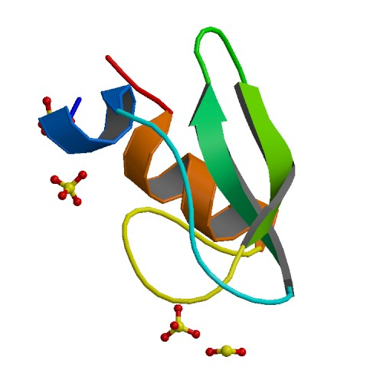
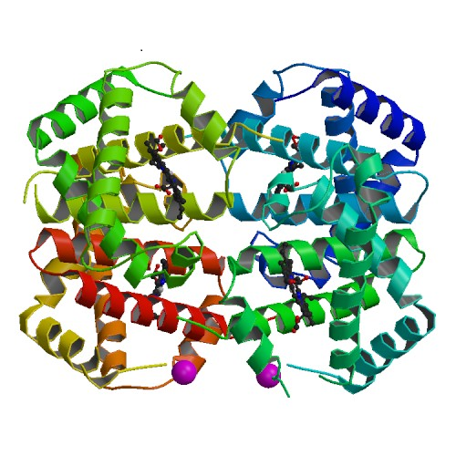
Comparing protein 3D structures
Structure of 1QLQ
Structure of 4HHB
Compare structures of two DIFFERENT proteins
Notes:
Several possible properties based on which two proteins can be compared. 3D structures is one of it.

Slide 5
Significance of comparing protein 3D structures
Structural similarity between two proteins means functional similarities
Predict binding site
Predict drug interaction
Notes:
Why is it useful..

Slide 6
Protein 3D structure comparison
Structural similarity between two proteins means functional similarities
Predict binding site
Predict drug interaction
Drug design
Drug delivery
Pharmacophore design
Notes:
Why is it useful..

Slide 7
Protein 3D structure comparison
Structural similarity between two proteins means functional similarities
Predict binding site
Predict drug interaction
Substrate interaction
Metabolic pathways
Disease pathways
Notes:
Why is it useful.. Medicines have a pathway and their functionality can be well determined by knowing the function of proteins they interact with

Slide 8
Atomic coordinates for protein 3D structure
X-ray diffraction method
Nuclear magnetic resonance method
Biochemical
Computational
(x, y, z) coordinates for every atom

Slide 9
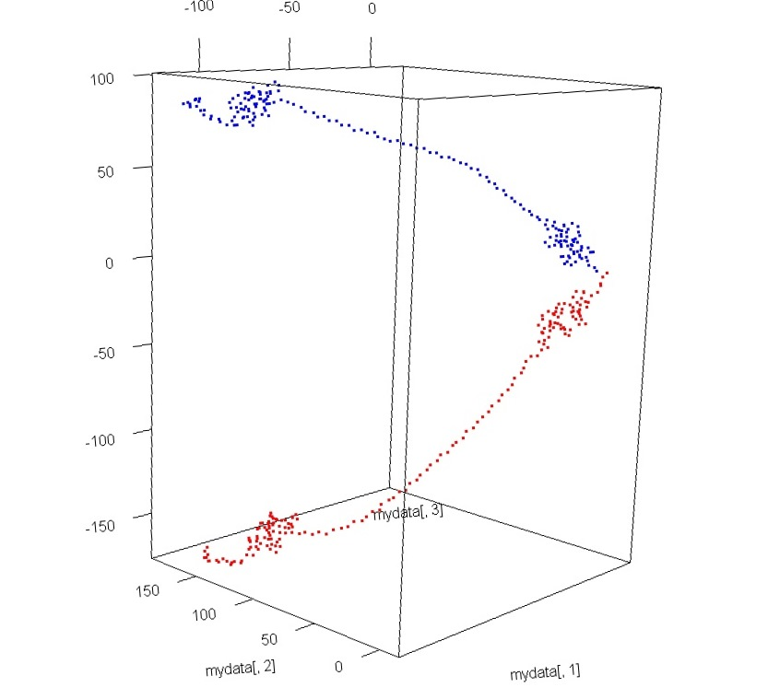
Limitation with available protein structure coordinates
PDBID:1b8t chain A NMR model 1
Lack of common frame of reference
Same protein, two experiments, two sets of coordinates
PDBID:1b8t chain A NMR model 10
Need for Structural Alignment before comparison

Slide 10
Protein structure comparison using structural alignment
Translation
Additional
Computation Cost
Rotation
Rotation
Lack of good alignment & global alignment does not mean good local alignment

Slide 11
Challenges with alignment: The inversion problem
Struct 1
Struct 2
Struct 2 is created by reversing the protein chain Struct1.
Same amino acids, same (x, y, z) coordinates, same length
Must result in 100% alignment
DALI
no alignment and considered the two dissimilar
FATCAT
71% alignment and considered to have good similarity

Slide 12
Overview of proposed solution and current contributions

Slide 13
A novel alignment free protein 3D comparison
Ability to find local 3D similarity measure
Ability to find global 3D similarity measure
Choice of a novel structural representation
Choice of similarity or dissimilarity measure
Mapping unique structural element to a unique key using Triangular Spatial Relationships (TSR)
Similarity functions that can take multi-sets as their arguments.

Slide 14
Current Contributions
Generalizing Triangular Spatial Relationships from 2D to 3D
Modifying Triangular Spatial Relationships to achieve scale sensitivity and incorporate ability to unify multiple objects into one class
Novel equal frequency binning method for discretization
Proof of desired property of triangular spatial relationships in 3D
Generalization of Jaccard and Overlap functions for similarity calculation

Slide 15
Background

Slide 16
Protein Structure
RPDFCLEPPYAGACRARIIRYFYNAKAGLCQ
Primary Structure
Sequence of Amino Acids.
Not enough for functional prediction.
Formed by 3D folding pattern of the protein. It makes protein functional.
Tertiary Structure
(3D Structure)
Notes:
Level of protein structure

Slide 17
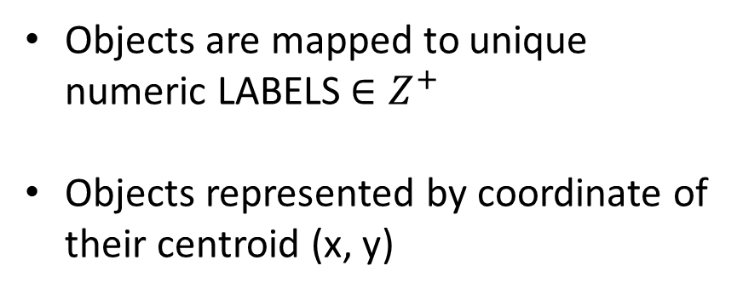
Triangular spatial relationships (TSR) in 2D
Triangular spatial relationships among objects in symbolic image
Objects are mapped to unique numeric LABELS $∈Z^{+}$
Objects represented by coordinate of their centroid (x, y)

Slide 18

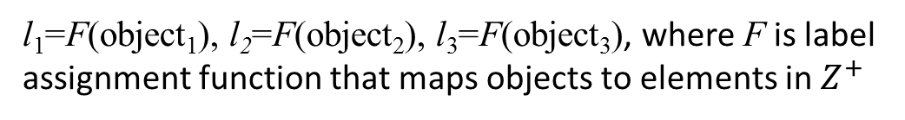



Triangular spatial relationships (TSR) in 2D
l₁
l₂
$$θ_{2}$$
1
2
$$θ_{1}$$
$$θ_{3}$$
Triples of non collinear objects
3
l₁=F(object₁), l₂=F(object₂), l₃=F(object₃), where F is label assignment function that maps objects to elements in $Z^{+}$
l₃
Triangular Spatial Relationship between objects in an image is given by quadruple of features
where Label₁, Label₂, Label₃ are permutation of l₁, l₂, l₃
$$\{{Label}_{1}, {Label}_{2}, {Label}_{3}, θ\}$$

Slide 19
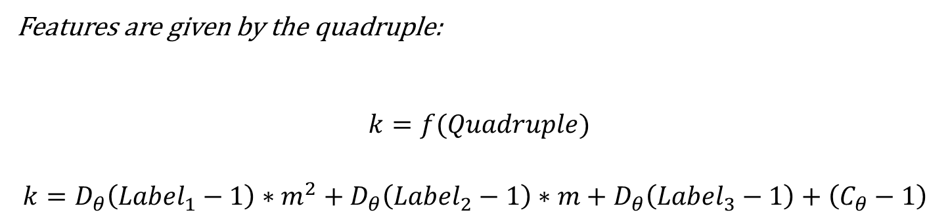
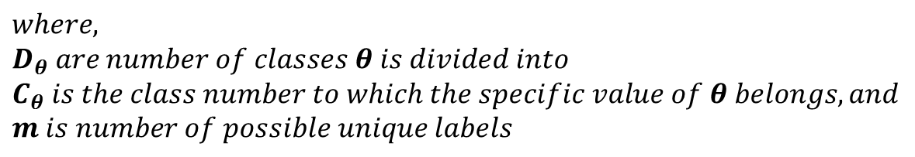
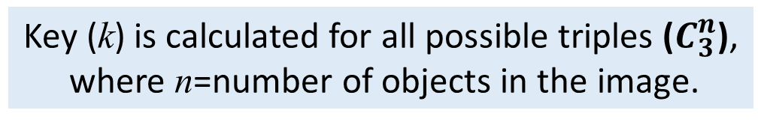

Mapping features to key in symbolic image
Features are given by the quadruple:
$$k=f(Quadruple)$$
$$k=D_{θ}\left({Label}_{1}−1\right)∗m^{2}+D_{θ}\left({Label}_{2}−1\right)∗m+D_{θ}\left({Label}_{3}−1\right)+\left(C_{θ}−1\right)$$
$$\{{Label}_{1}, {Label}_{2}, {Label}_{3}, θ\}$$
$$where,$$
$$D_{θ} are number of classes θ is divided into$$
$$C_{θ} is the class number to which the specific value of θ belongs, and$$
$$m is number of possible unique labels$$
Key (k) is calculated for all possible triples ($C_{3}^{n}$),
where n=number of objects in the image.
Notes:
N choose three

Slide 20

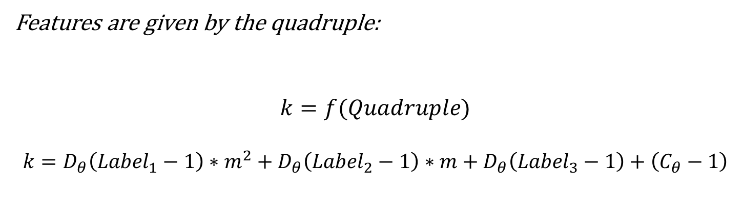
Properties of TSR in 2D
Features are given by the quadruple:
$$k=f(Quadruple)$$
$$k=D_{θ}\left({Label}_{1}−1\right)∗m^{2}+D_{θ}\left({Label}_{2}−1\right)∗m+D_{θ}\left({Label}_{3}−1\right)+\left(C_{θ}−1\right)$$
$$\{{Label}_{1}, {Label}_{2}, {Label}_{3}, θ\}$$
Properties of TSR in 2D
-------------------------------
Rotation invariant
Translation invariant
Scale insensitivity

Slide 21



Computing similarity between two images
Original Image A
Query Image B
($C_{3}^{nA}$)
($C_{3}^{nB}$)
Keys representing image A
Keys representing image B
Similarity Computation
$$k_{AB}/k_{B}$$
$$k_{AB}=common keys$$
$$k_{B}=keys in query image$$

Slide 22
Triangular Spatial Relationships for protein 3D structure representation

Slide 23
From image comparison to protein 3D structure comparison
Structure of 1QLQ
Structure of 4HHB
TSR Keys representing 1QLQ
TSR Keys representing 4HHB
Similarity Computation
Modified Jaccard Coefficient that allow multi-sets as its arguments
Modified Overlap Function that allow multi-sets as its arguments

Slide 24
Current Contributions
Generalizing Triangular Spatial Relationships from 2D to 3D
Modifying Triangular Spatial Relationships to achieve scale sensitivity and incorporate ability to unify multiple objects into one class
Novel equal frequency binning method for discretization
Proof of desired property of triangular spatial relationships in 3D
Generalization of Jaccard and Overlap functions for similarity calculation

Slide 25



Generalizing TSR from 2D to 3D
$$\{{Label}_{1}, {Label}_{2}, {Label}_{3}, θ\}$$
$$k_{2D}=f({Quadruple}_{2D})$$
$$k_{3D}=f_{3D} ({Quadruple}_{3D})$$
Triples in 2D and 3D are represented by objects in same plane
$$k=D_{θ}\left({Label}_{1}−1\right)∗m^{2}+D_{θ}\left({Label}_{2}−1\right)∗m+D_{θ}\left({Label}_{3}−1\right)+\left(C_{θ}−1\right)$$
Desired properties
---------------------------
Rotation invariant
Translation invariant
Scale insensitivity

Slide 26
Need for scale sensitivity-
b
a
θ₁
θ₁
Same keys but functionally different

Slide 27
Need for scale sensitivity- problem of repeating keys
% Unique keys w.r.t Total key
Samples
On an average unique keys were less than 5% of the total keys

Slide 28
Current Contributions
Generalizing Triangular Spatial Relationships from 2D to 3D
Modifying Triangular Spatial Relationships to achieve scale sensitivity and incorporate ability to unify multiple objects into one class
Novel equal frequency binning method for discretization
Proof of desired property of triangular spatial relationships in 3D
Generalization of Jaccard and Overlap functions for similarity calculation

Slide 29

Structural elements represented by quintuple of features
$$\{{Label}_{1}, {Label}_{2}, {Label}_{3}, θ, D\}$$
Labels represent Primary Structure (amino acids sequence)
Tertiary/ 3D structure
Theta represents orientation
Length represents size/scale

Slide 30


Scale sensitive Triangular Spatial Relationships in 3D
$$k=f_{3D}^{s} (QUINTUPLE)$$
$$\{{Label}_{1}, {Label}_{2}, {Label}_{3}, θ, D\}$$
k= m²|N_{θ}||N_{D}|(Label₁ -1)+m|N_{θ}||N_{D}|(Label₂ -1)+|N_{θ}||N_{D}|(Label₃ -1)+|N_{D}|(c_{θ}-1)+c_{D}-1
where,
  m is number of labels,
  N_{θ} is number of classes of angles,
  N_{D} is number of classes of length,
  c_{θ} is the class number of θ, and
  c_{D} is the class number of D

Slide 31
Scale sensitivity
% Unique keys w.r.t Total key
Samples
On an average unique keys were 80% of the total number of keys

Slide 32
Current Contributions
Generalizing Triangular Spatial Relationships from 2D to 3D
Modifying Triangular Spatial Relationships to achieve scale sensitivity and incorporate ability to unify multiple objects into one class
Novel equal frequency binning method for discretization
Proof of desired property of triangular spatial relationships in 3D
Generalization of Jaccard and Overlap functions for similarity calculation

Slide 33


TSR 3D sensitivity to evolutionary grouping of amino acids
$$\{{Label}_{1}, {Label}_{2}, {Label}_{3}, θ, D\}$$
$$k= f_{3D}^{G}(QUINTUPLE)$$
k= |N_{L}|²|N_{θ}||N_{D}|(c_{L1} -1)+|N_{L}||N_{θ}||N_{D}|(c_{L2} -1)+|N_{θ}||N_{D}|(c_{L3} -1)+|N_{D}|(c_{θ}-1)+c_{D}-1
where,
  N_{L} number of classes of labels,
  N_{θ} number of classes of angles,
  N_{D} number of classes of length,
  c_{Li} is class number of amino acid1, amino acid2, amino acid 3
  c_{θ} is the class number of θ, and
  c_{D} is the class number of D

Slide 34
Triangular Spatial Relationships for protein 3D structure
COMPUTING KEYS

Slide 35

Steps towards key calculation for 3D structure
$$k=f_{3D}^{s}(QUINTUPLE)$$
k= m²|N_{θ}||N_{D}|(Label₁ -1)+m|N_{θ}||N_{D}|(Label₂ -1)+|N_{θ}||N_{D}|(Label₃ -1)+|N_{D}|(c_{θ}-1)+c_{D}-1
Information extraction from data
Quintuples Generation
Key calculation

Slide 36
Computing keys
INFORMATION EXTRACTION FROM DATA

Slide 37
Data and its source
Protein Structure Information as available in PDB format
Protein Data Bank (PDB) is a free world wide repository of protein structures

Slide 38
PDB format -- Data description
Each PDB file represents one protein
Each protein can have several models
Each model can have several chains & every chain is a sequence of amino acid
A PDB file has coordinate information on each atom of the amino acid
There may be coordinate information unavailable &/repeating for atoms&/amino acids

Slide 39
Structural coordinate extraction
Choose a model– Usually first one is best
Choose chain of interest from model
Remove repeating coordinate information atoms/amino acids and ignore unavailable
Extract sequence information
Extract C_{α} atom (representing centroid) and its coordinates for sequence

Slide 40




Centroid of amino acid
Backbone of a protein
Stereo center of each amino acid
Role in protein Folding
Good approximator of amino acid location
$$H$$
C_{α}
$${NH}_{3}^{+}$$
$${COO}^{−}$$
(x,y,z) of C_{α} of 1st amino acid of triple
$$R$$
(x,y,z) of C_{α} of 2nd amino acid of triple
(x,y,z) of C_{α} of 3rd amino acid of triple
Notes:
X,y,z coordinates for Centroid of amino acids are represented by c-alpha atom

Slide 41
Computing keys
QUINTUPLE GENERATION

Slide 42
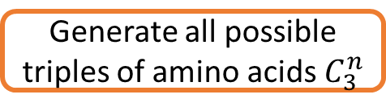

Triples, Angle and Length
Generate all possible triples of amino acids $C_{3}^{n}$
Assign labels to amino acids in triple
Perform rule based label arrangement
Label₃
d13
d23
Calculate Angle and Length
$$\{{Label}_{1}, {Label}_{2}, {Label}_{3}, θ, D\}$$
θ₁
Quintuple
Label₁
Label₂
d12
Representative Length (D)

Slide 43
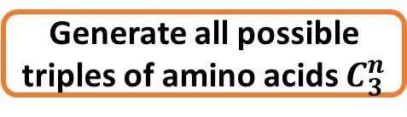

Triples, Angle and Length
Generate all possible triples of amino acids $C_{3}^{n}$
Assign labels to amino acids in triple
Represented by the (x, y, z) of centroid (C_{α} ) of each amino acid
Perform rule based label arrangement
Label₃
d13
d23
Calculate Angle and Length
$$\{{Label}_{1}, {Label}_{2}, {Label}_{3}, θ, D\}$$
θ₁
Quintuple
Label₁
Label₂
d12
Representative Length (D)

Slide 44
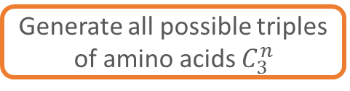
Triples, Angle and Length
Generate all possible triples of amino acids $C_{3}^{n}$
Assign labels to amino acids in triple
Represented by the centroid (C_{α} ) of each amino acid
Perform rule based label arrangement
Label₃
d13
d23
Calculate Angle and Length
$$\{{Label}_{1}, {Label}_{2}, {Label}_{3}, θ, D\}$$
θ₁
Quintuple
Label₁
Label₂
d12
Representative Length (D)

Slide 45

Numeric LABEL to amino acids in triple
$$\{{Label}_{1}, {Label}_{2}, {Label}_{3}, θ, D\}$$
Numeric codes for amino acids
a₁, …,a₂₀∈ AminoAcid → A
l₁, l₂, l₃, .., l₂₀ ∈ Z⁺
F : A → Z⁺
Continuous
Unique
∈ Z⁺
Amino acids have been arranged in lexicographic order
Notes:
Unique contious numeric labels assigned to amino acids arranged in lexigographic order

Slide 46
Triples, Angle and Length
Generate all possible triples of amino acids $C_{3}^{n}$
Assign labels to amino acids in triple
Represented by the centroid (C_{α} ) of each amino acid
Perform rule based label arrangement in every triple
Label₃
d13
d23
Calculate Angle and Length
$$\{{Label}_{1}, {Label}_{2}, {Label}_{3}, θ, D\}$$
θ₁
Quintuple
Label₁
Label₂
d12
Representative Length (D)

Slide 47

Rule based label arrangement
Theta and Length are calculated based on Label arrangement
$$\{{Label}_{1}, {Label}_{2}, {Label}_{3}, θ, D\}$$
l₁
d13
d13
Label₁=max(l₁, l₂, l₃)
Label₂=max((l₁, l₂, l₃)-max(l₁, l₂, l₃))
Label₃=min(l₁, l₂, l₃)
l₃
l₃
d23
Case1:
l₁ > l₂ = l₃
____________
Label₁:=l₁,
If d12>d13 then
  Lable₂:=l₂
Else
  Label₂:=l₃
Case:
l₁ = l₂ > l₃
_______________
Lable₃:=l₃
If d13>d23 then
  Label₁:=l₁
Else
  Label₁:=l₂
Case:
l₁ = l₂ = l₃
________________________
If d12>max(d13,d23) then
  Lable₁:=l₁
  If d12>d13 then
    Label₂:=l₂
  :
  :
Notes:
Must for calculating unique keys

Slide 48
Triples, Angle and Length
Generate all possible triples of amino acids $C_{3}^{n}$
Assign labels to amino acids in triple
Represented by the centroid (C_{α} ) of each amino acid
Perform rule based label arrangement
Label₃
d13
d23
Calculate Angle and Length
$$\{{Label}_{1}, {Label}_{2}, {Label}_{3}, θ, D\}$$
θ₁
Quintuple
Label₁
Label₂
d12
Representative Length (D)

Slide 49
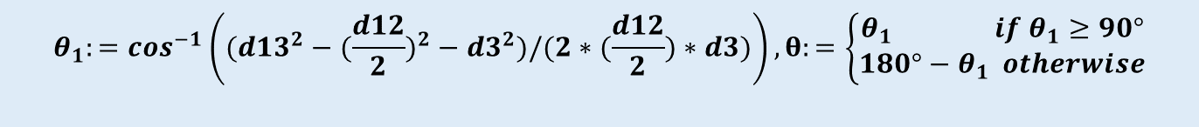
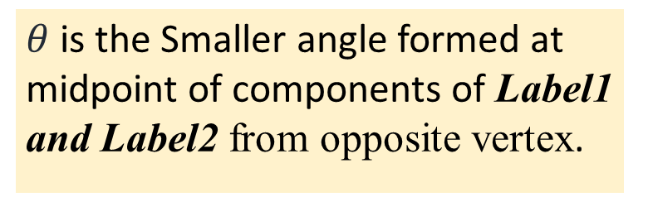

THETA and LENGTH in Quintuple
$$\{{Label}_{1}, {Label}_{2}, {Label}_{3}, θ, D\}$$
Label₃
$θ$is the Smaller angle formed at midpoint of components of Label1 and Label2 from opposite vertex.
d13
d23
θ₁
d3
Label₁
Label₂
d12
D:=d12
Representative Length (D)
$$θ_{1}:=\cos^{−1}\left(({d13}^{2}−({\frac{d12}{2})}^{2}−{d3}^{2})/(2∗(\frac{d12}{2})∗d3)\right), θ:=\left\{\begin{aligned}θ_{1} if θ_{1}≥90° \\ 180°−θ_{1} otherwise\end{aligned}\right.$$

Slide 50

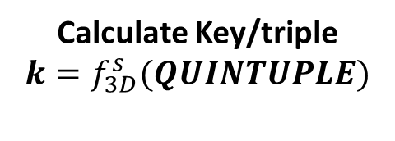
Triples, Angle and Length
Generate all possible triples of amino acids $C_{3}^{n}$
Assign labels to amino acids in each triple
Represented by the centroid (C_{α} ) of each amino acid for protein sequence
Perform rule based label arrangement/ triple
Label₃
d13
d23
Calculate Angle and Length
$$\{{Label}_{1}, {Label}_{2}, {Label}_{3}, θ, D\}$$
θ₁
Quintuple
Label₁
Label₂
Calculate Key/triple
$$k=f_{3D}^{s}(QUINTUPLE)$$
d12
Representative Length (D)

Slide 51

Key calculation
For Quintuple
$$\{{Label}_{1}, {Label}_{2}, {Label}_{3}, θ, D\}$$
Apply Function to Quintuples
k= m²|N_{θ}||N_{D}|(Label₁ -1)+m|N_{θ}||N_{D}|(Label₂ -1)+|N_{θ}||N_{D}|(Label₃ -1)+|N_{D}|(c_{θ}-1)+c_{D}-1
Need to Discretize
Number of classes of angles
Number of classes of lengths
Bin Boundaries of each angle class
Bin Boundaries of each length class

Slide 52
Computing keys
DISCRETIZATION

Slide 53
Current Contributions
Generalizing Triangular Spatial Relationships from 2D to 3D
Modifying Triangular Spatial Relationships to achieve scale sensitivity and incorporate ability to unify multiple objects into one class
Novel equal frequency binning method for discretization
Proof of desired property of triangular spatial relationships in 3D
Generalization of Jaccard and Overlap functions for similarity calculation.

Slide 54
Discretization standard methods
Unsupervised Discretization
Equal Width Binning
Novel Equal Frequency Binning
In TSR -2D
In TSR -3D
To ensure that a random variable (angle/ length value) has equal probability of falling in any class

Slide 55

Data used to decide the bin boundaries and number of bins
$$Angles=\left\{θ_{1}, θ_{2, }θ_{3}\right\},$$
$$Lengths=\{d12, d13,d23\}$$
Length (d12)
θ₂
Length (d13)
θ₃
θ₁
Length (d23)

Slide 56
Data in support of equal frequency binning of length
Length count plot

Slide 57
Data in support of equal frequency binning of angle
Angle count plot

Slide 58
Problems with standard equal frequency binning
1. Need for user defined number of bins to start with
2. Instances where different occurrences of same value may land in different bins.
1
2
3
3
4
4
4
4
4
4
1
2
3
3
4
Bin 1
Bin 2
4
4
4
4
4

Slide 59
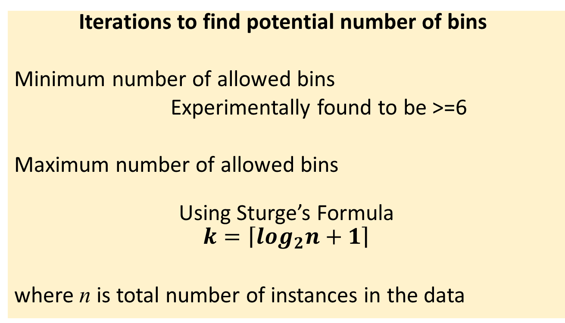
Iterative binning
Iterations to find potential number of bins
Minimum number of allowed bins
Experimentally found to be >=6
Maximum number of allowed bins
Using Sturge’s Formula
$$k=\left\lceil \log_{2}n+1\right\rceil$$
where n is total number of instances in the data

Slide 60

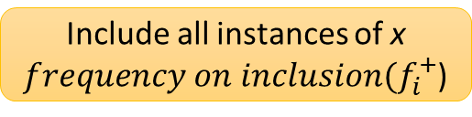



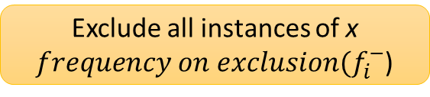
Adaptive binning
Automatically ADAPTS bin boundaries to ensure all occurrences of same value are in one bin.
For a value x, that is not completely in the bin i, if ${frequency(f}_{i})>expected frequency (ε)$
Two possible options
Include all instances of x
$frequency on inclusion(f_{i}^{+}$)
Exclude all instances of x
$frequency on exclusion(f_{i}^{−}$)
Calculate deviation
$${dev}^{+}=abs(ε−f_{i}^{+})$$
${dev}^{−}= abs(ε−f_{i}^{−}$ )
Bin boundary decision
$$min⁡({dev}^{−},{dev}^{+})$$
Notes:
Adapts the bin boundary to Minimize the intra bin deviation from expected bin frequency.

Slide 61
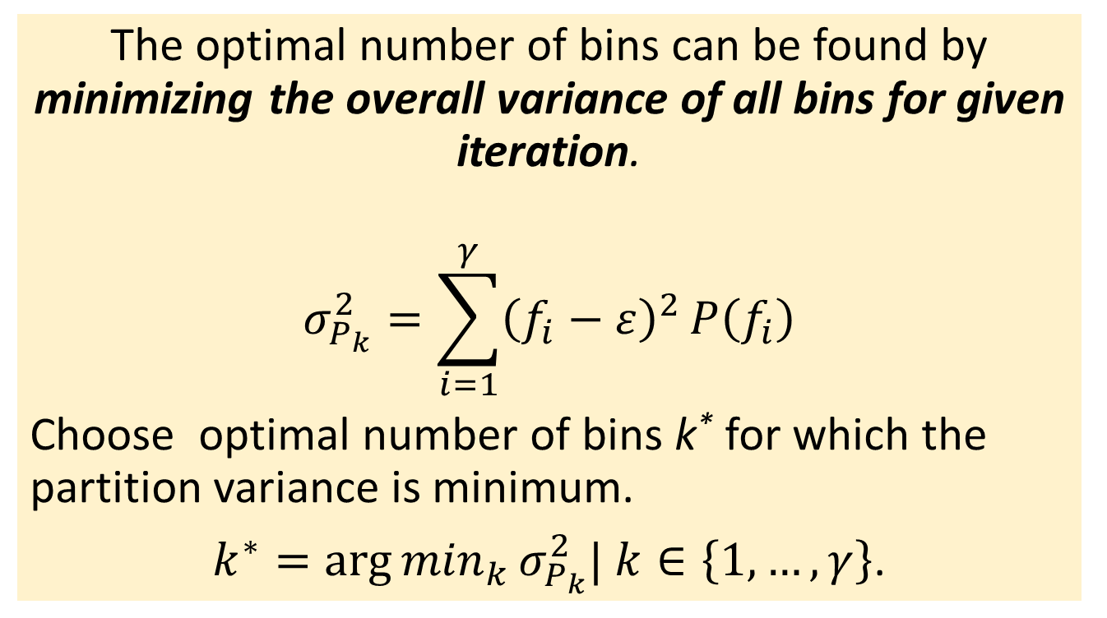
Optimal number of bins
The optimal number of bins can be found by minimizing the overall variance of all bins for given iteration.
$$σ_{P_{k}}^{2}=\sum_{i=1}^{γ}{{\left(f_{i}−ε\right)}^{2}}P\left(f_{i}\right)$$
Choose optimal number of bins k* for which the partition variance is minimum.
$k^{∗}={\arg{min}}_{k}σ_{P_{k}}^{2}| k∈\left\{1,…, γ\right\}$.
Notes:
Overall variance is calculated for a given iteration as sum of deviation for each bin. The optimal number of bins are chosen based on minimizing the variation.

Slide 62
Number of bins for length vs. variance
Minimum Variance

Slide 63
Number of bins for angle Vs. variance
Choice for number of bins

Slide 64
Triangular Spatial Relationships for protein 3D structure
PROOF OF DESIRABLE PROPERTY

Slide 65
Current Contributions
Generalizing Triangular Spatial Relationships from 2D to 3D
Modifying Triangular Spatial Relationships to achieve scale sensitivity and incorporate ability to unify multiple objects into one class
Novel equal frequency binning method for discretization
Proof of desired property of triangular spatial relationships in 3D
Generalization of Jaccard and Overlap functions for similarity calculation.

Slide 66

Proof of desirable properties
$$k=f_{3D}^{s}(QUINTUPLE)$$
Function $f_{3D}^{s}$ is deterministic
Function 𝒇_𝟑𝑫^𝒔 is deterministic
Key $f_{3D}^{s}$(Quintuple) is scale sensitive
Key 𝒇_𝟑𝑫^𝒔(Quintuple) is scale sensitive
Key $f_{3D}^{s}$(Quintuple) is rotation and translation invariant
Key 𝒇_𝟑𝑫^𝒔(Quintuple) is rotation and translation invariant

Slide 67
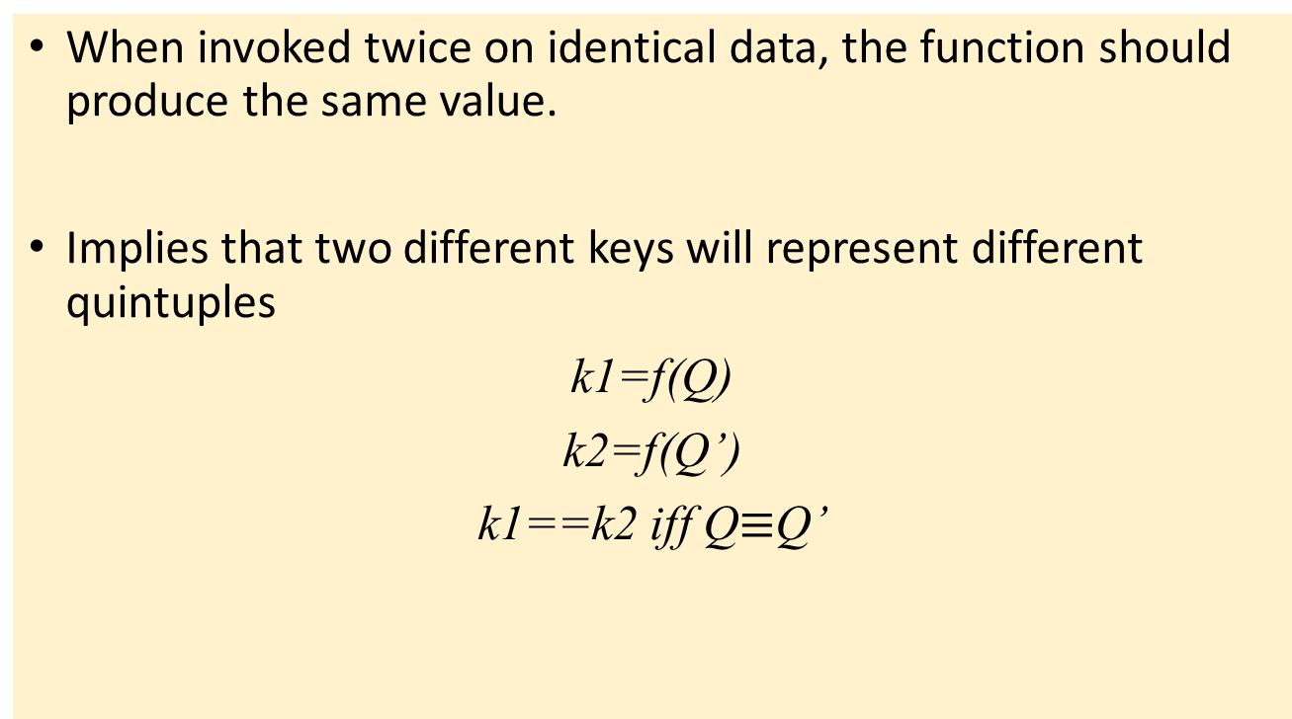
Deterministic
When invoked twice on identical data, the function should produce the same value.
Implies that two different keys will represent different quintuples
k1=f(Q)
k2=f(Q’)
k1==k2 iff Q$≡$Q’
Notes:
Quintuples are ISOMORPHIC with exception of rotation, translation

Slide 68
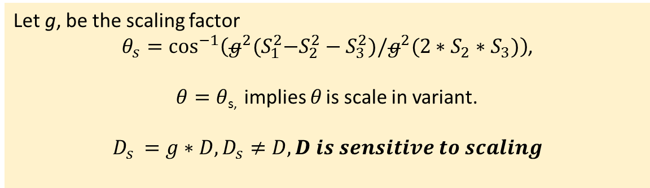
Scale Sensitive
θ₁
g*θ₁
D
g*D
Let g, be the scaling factor
$θ_{s}=\cos^{−1}\left(g^{2}{(S}_{1}^{2}−S_{2}^{2}−S_{3}^{2})/g^{2}(2∗S_{2}∗S_{3})\right)$,
$θ=θ$_{s,} implies $θ$ is scale in variant.
$$D_{s }=g∗D, D_{s}≠D, D is sensitive to scaling$$

Slide 69
Invariance result
P
Translation
P^{T}
P
Rotation
All the keys remain unchanged
P^{R}
Translation + Rotation
P
P^{TR}

Slide 70
SIMILARITY MEASURE
INTRODUCTION

Slide 71
Good measure of similarity
Protein structures are represented using multi-set of keys, the similarity measure must be able to take multi-set input in the form of key-count pair
Jaccard Coefficient
Overlap Function
Notes:
Variation of Jaccard coeffifient and overlap function

Slide 72
Current Contributions
Generalizing Triangular Spatial Relationships from 2D to 3D
Modifying Triangular Spatial Relationships to achieve scale sensitivity and incorporate ability to unify multiple objects into one class
Novel equal frequency binning method for discretization
Proof of desired property of triangular spatial relationships in 3D
Generalization of Jaccard and Overlap functions for similarity calculation to multi-set as argument

Slide 73
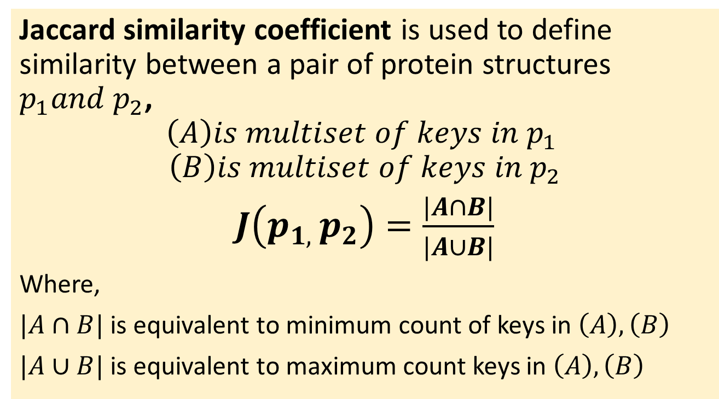
Statistical measure of the similarity
Jaccard similarity coefficient is used to define similarity between a pair of protein structures $p_{1}and p_{2}$,
$$\left(A\right)is multiset of keys in p_{1}$$
$$\left(B\right)is multiset of keys in p_{2}$$
$J\left(p_{1, }p_{2}\right)=\frac{|A∩B|}{|A∪B|}$
Where,
$|A∩B|$ is equivalent to minimum count of keys in $\left(A\right),\left(B\right)$
$|A∪B|$ is equivalent to maximum count keys in $\left(A\right),\left(B\right)$

Slide 74
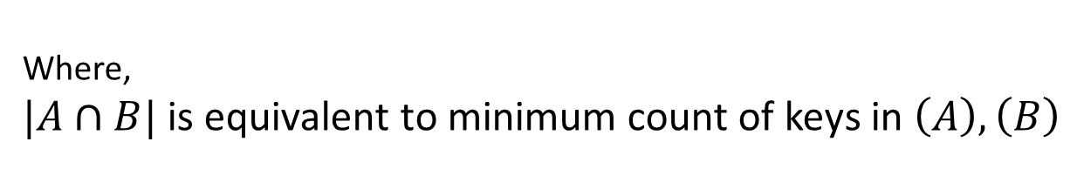
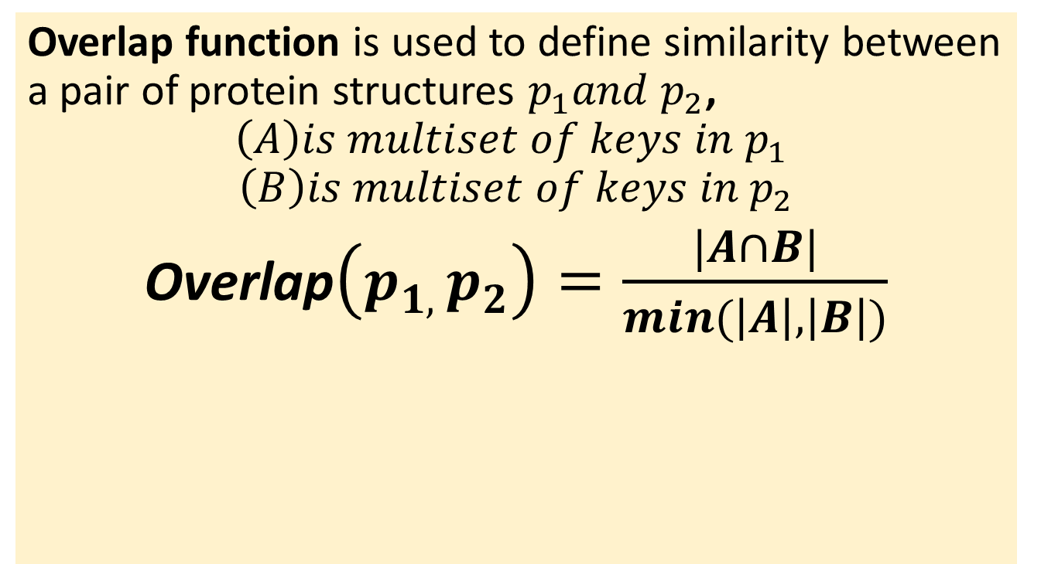
Statistical measure of the similarity
Overlap function is used to define similarity between a pair of protein structures $p_{1}and p_{2}$,
$$\left(A\right)is multiset of keys in p_{1}$$
$$\left(B\right)is multiset of keys in p_{2}$$
Overlap$\left(p_{1, }p_{2}\right)=\frac{|A∩B|}{min(\left|A\right|,\left|B\right|)}$
Where,
$|A∩B|$ is equivalent to minimum count of keys in $\left(A\right),\left(B\right)$

Slide 75
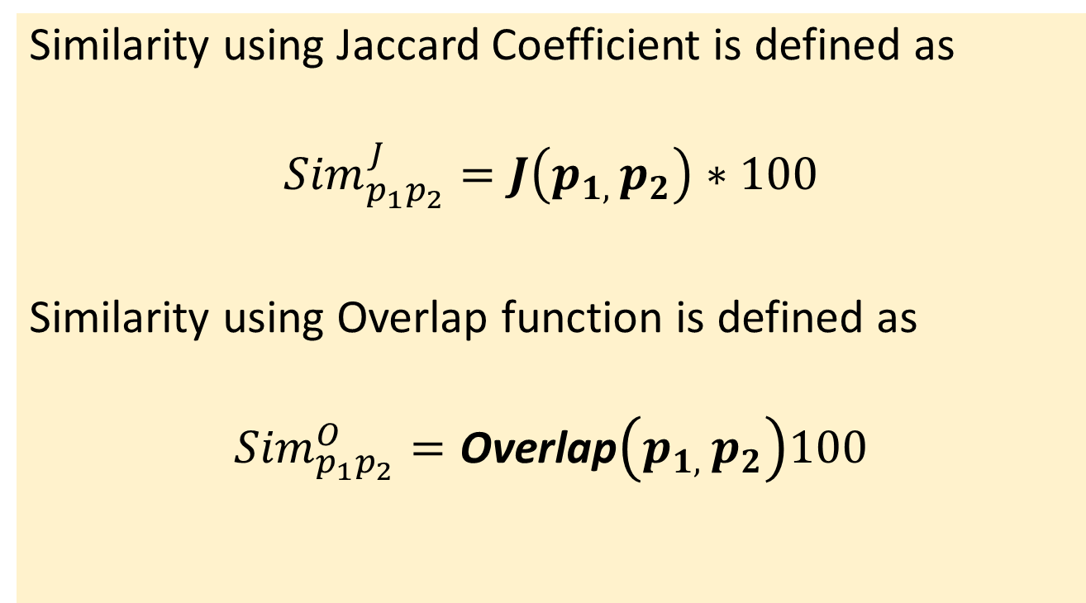
Defining similarity
Similarity using Jaccard Coefficient is defined as
$${Sim}_{p_{1}p_{2}}^{J}=J\left(p_{1, }p_{2}\right)∗100$$
Similarity using Overlap function is defined as
$${Sim}_{p_{1}p_{2}}^{O}=\text{Overlap}\left(p_{1, }p_{2}\right)100$$

Slide 76
SIMILARITY MEASURE
RESULTS

Slide 77
The inversion problem solved with TSR 3D
Struct 1
Struct 2
Similarity between Struct1 and Struct2 when represented using TSR in 3D resulted in 100% similarity
Struct 2 is created by reversing the protein chain Struct1. It preserves the length, directionality and all of the properties of original structure given by Struct1.
Must result in 100% alignment
DALI no alignment and considered the two dissimilar
FATCAT 71% alignment and considered to have good similarity

Slide 78
Finding local similarity
Finding STRUCTURAL MOTIFS in kinases
k= m²|N_{θ}||N_{D}|(Label₁ -1)+m|N_{θ}||N_{D}|(Label₂ -1)+|N_{θ}||N_{D}|(Label₃ -1)+|N_{D}|(c_{θ}-1)+c_{D}-1
Common for the motif, results in keys with different last two digits.
Notes:
Keys of same motifs will differ only on most two significance values. D= aspartic acid, G=glycine, F=phenylalanine

Slide 79
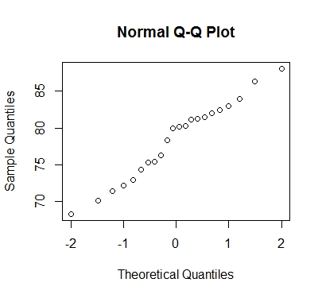
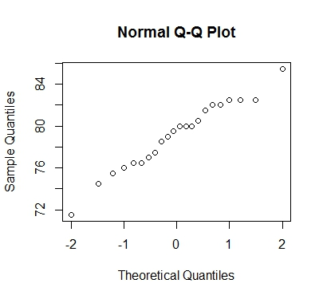
Compare pairwise similarity using Jaccard (TSR-3D) with FATCAT
Test of normality for pairwise similarity calculated using Jaccard Coefficient
Test of normality for pairwise similarity calculated using FATCAT method

Slide 80
T-test for testing if TSR 3D and FATCAT produce similar results
R output:
Welch Two Sample t-test
p-value = 0.5985
Null hypothesis:
True difference in means is equal to 0
Alternative hypothesis:
True difference in means is not equal to 0
Conclusion:
We cannot reject null hypothesis as p-value>0.05

Slide 81
WORK IN PROGRESS

Slide 82
Future work
Performance improvement
Database of TSR 3D keys for protein 3D structure
Structural similarity graph of proteins with common domains

Slide 83
Performance improvement
Improving speed
Improving accuracy
-----------------------------------------------------
Improving speed:
Parallelization of similarity calculation using HADOOP.
The keys are represented in form of key-value pair and can be used directly to calculate pairwise 3D structural similarity in parallel using HADOOP.

Slide 84
Performance improvement continued..
Improving accuracy:
-- Using generalized Overlap function as measure of similarity
-- Refining discretization to maximize the accuracy

Slide 85
Database of TSR 3D keys
Purpose: Most available systems only allow PDB id as query. The proposed database will allow query diversity and speed.
----------------------------------------------------------
Allowed query types:
1. sequence information + corresponding Cα(x,y,z)
2. PDB file
3. PDB id
Fast access will be made possible by using B+ tree datastructure and its implementation in databases.

Slide 86
Database of TSR 3D keys continued..
Choice of comparison:
Comparison of two structures where queries are database IDs (like PDB ID for protein);
Comparison of two structures where queries are structure files;
Finding similar structures based on single query database ID;
Finding similar structures based on single query structure file;
Finding similar structures based on partial coordinate file of a substructure

Slide 87
Database of TSR 3D keys continued..
Output Description:
The features of the output files includes
(i) overall similarity with the statistics values;
(ii) the rank from the most similar overall and local structures with their associated keys;
(iii) a structure tree for multiple structures.

Slide 88
Structural similarity graph of proteins with common domains
Method for finding the global structural connectivity between proteins that contain a specific domain of interest. A similar domain not necessarily results in global similarity. A map of structural connectivity will help visualize the global similarity pattern

Slide 89
Structural similarity maps of proteins with common domains continued…
Amino acid groups for the domain
Find the evolutionary grouping among the amino acids BLOSUM or PAM matrix.
Key calculation
k= |N_{L}|²|N_{θ}||N_{D}|(c_{L1} -1)+|N_{L}||N_{θ}||N_{D}|(c_{L2} -1)+|N_{θ}||N_{D}|(c_{L3} -1)+|N_{D}|(c_{θ}-1)+c_{D}-1
Dataset
Structural Domain data from SCOP database

Slide 90
CONCLUSION

Slide 91
Conclusion
This work extends the idea of TSR used for 2D image comparisons to 3D protein structure comparison using novel feature and key mapping function which is scale sensitive.
It introduced generalization of Jaccard and Overlap functions for similarity calculation to include multi-sets as argument.
It has been shown to identify local similarity and structural motifs.
The pairwise global similarity measure calculated using TSR 3D have been found to be comparable to other methods.

Slide 92
Thank You
Questions

